Slide 1
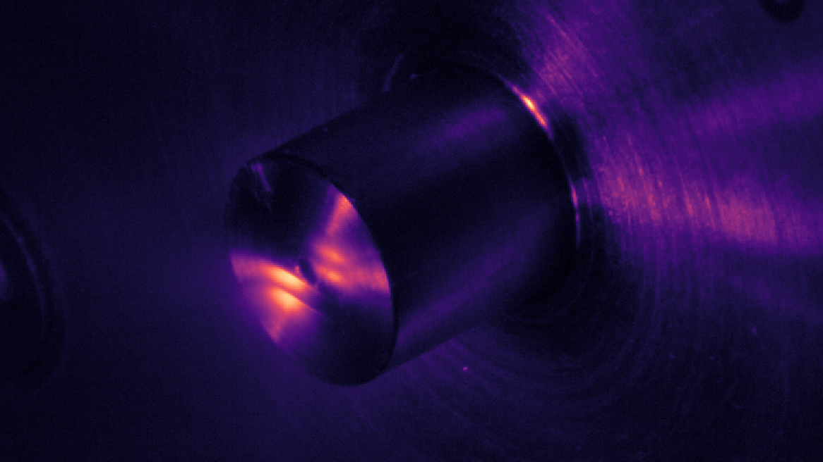
Complex Attosecond Transient-absorption
Spectroscopy
Stephen J. Hageman
Agostini-DiMauro Ultrafast Atomic Physics Research Group
Ph.D. Dissertation Defense
Dec. 8, 2020

Slide 2
Academic History
B.S. Physics and Mathematics, Johns Hopkins University……………………………………………………….................
Entered OSU physics graduate program………………………………………………………….........................................
Completed candidacy exam……………………………………………………………………………………………………………….....
M.S. Physics, OSU…………………………………………………………………………………………………………………………………..
2011
2012
2014
2014
Publication List
Cr:ZnSe mid-IR, multi-mJ, few-cycle amplifier: a new platform for attosecond soft-X-ray physics
V. E. Leshchenko, B. K. Talbert, Y. H. Lai, S. Li, Y. Tang, S. J. Hageman, G. Smith, P. Agostini, L. F. DiMauro, and C. I. Blaga, Optica 7 (8), 981-988 (2020)
High relative-phase precision beam duplicator for mid-infrared femtosecond pulses
A. Camper, H. Park, S. J. Hageman, G. Smith, T. Auguste, P. Agostini, and L. F. DiMauro, Optics Letters, 44 (22), 5465-5468 (2019)
Epitaxial films of Heusler compound Co₂FeAl_{0.5}Si_{0.5} with high crystalline quality grown by off-axis sputtering
B. Peters, A. Alfonsov, C. G. F. Blum, S. J. Hageman, P. M. Woodward, S. Wurmehl, B. Büchner, and F. Y. Yang, Appl. Phys. Lett. 103, 162404 (2013)
Parallel fabrication of magnetic tunnel junction nanopillars by nanosphere lithography
W. G. Wang, A. Pearse, M. Li, S. Hageman, A. X. Chen, F. Q. Zhu, and C. L. Chien, Scientific Report 3, 1948 (2013)
Electric-field-assisted switching in magnetic tunnel junctions
W. G. Wang, M. Li, S. Hageman, and C. L. Chien, Nature Mater. 11, 64 (2012)
Thermal annealing study of magnetoresistance and perpendicular anisotropy in magnetic tunnel junctions based on MgO and CoFeB
W. G. Wang, S. Hageman, M. Li, S. X. Huang, X. M. Kou, X. Fan, J. Q. Xiao, and C. L. Chien, Appl. Phys. Lett. 99, 102502 (2011)

Slide 3
Outline
Introduction
Experimental Apparatus: Transient absorption beamline (TABLe)
Experimental Investigations
Two-source high-harmonic generation using a square-wave phase grating (SWPG)
Measurement of refractive index using a SWPG
Attosecond Transient-absorption spectroscopy of argon Fano resonances
Complex Attosecond Transient-absorption Spectroscopy (CATS)

Slide 4
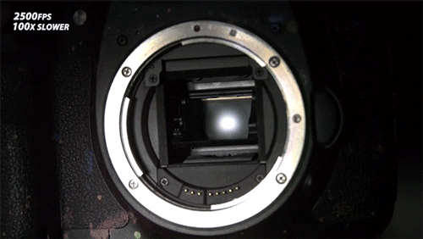
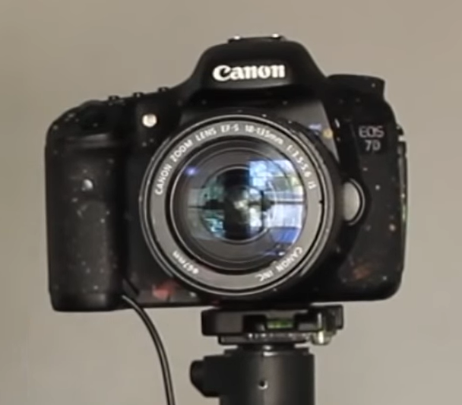
Introduction: measuring fast events
How can you study the shutter mechanism of a DSLR camera, using a DSLR?
What shutter speed would you need?
Your shutter speed needs to be faster than what you want to study!

Slide 5
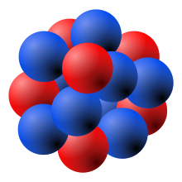
Introduction: measuring fast events
How about motion of electrons in an atom?
Electron orbits hydrogen nucleus 6.67 x 10¹⁵ times per second, every 150 as (10⁻¹⁸ s)
To see this, you would need a “shutter” speed faster than 150 as
This can be done using lasers!

Slide 6
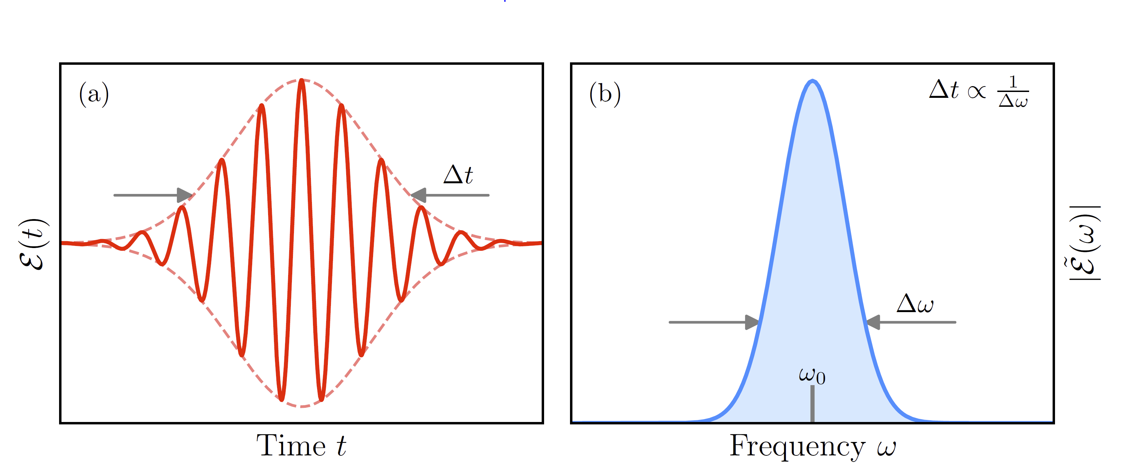
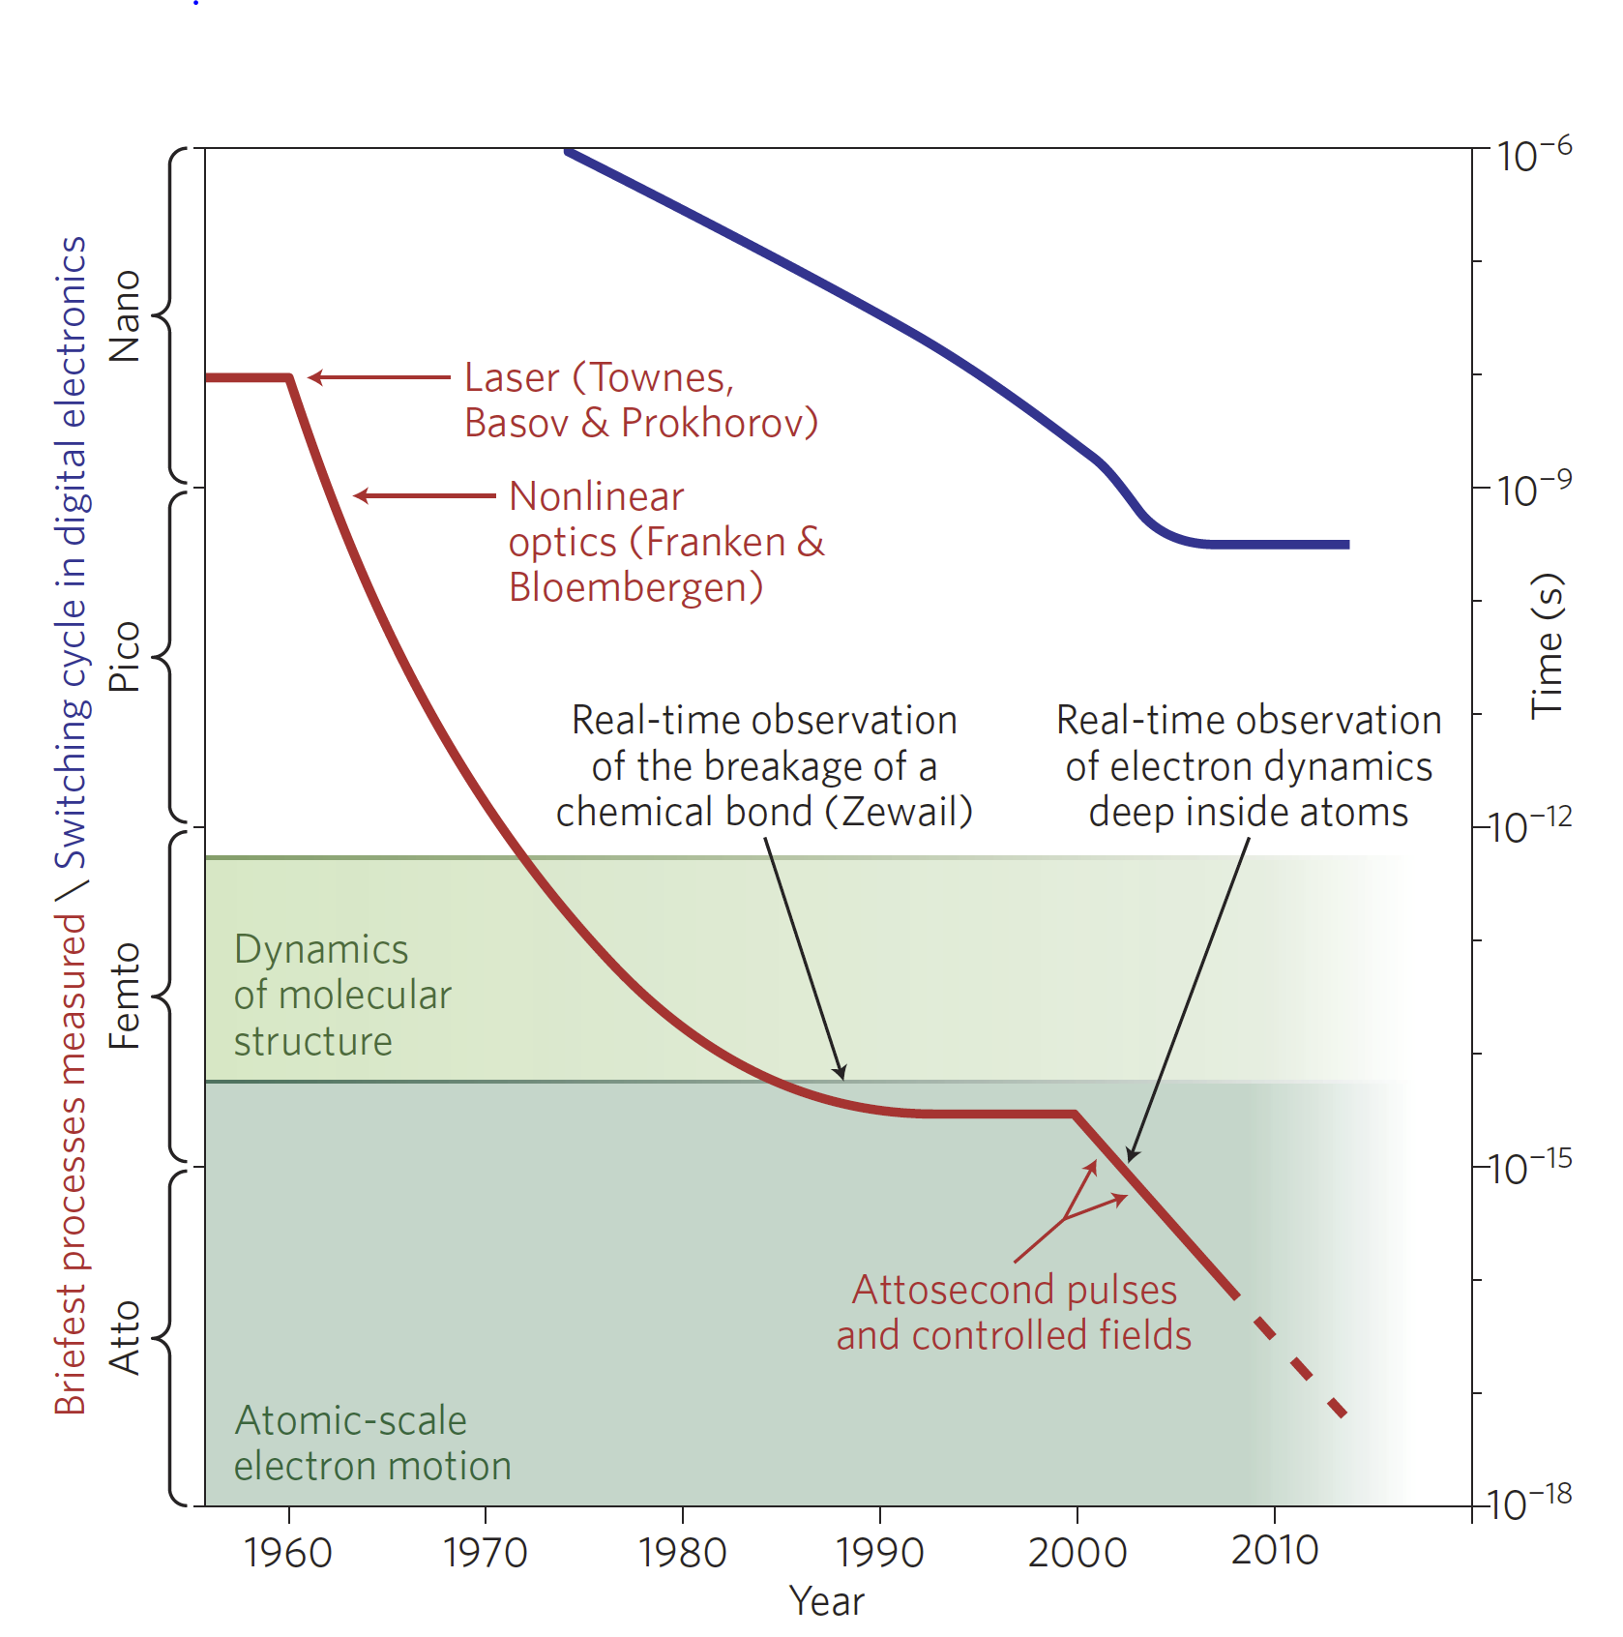
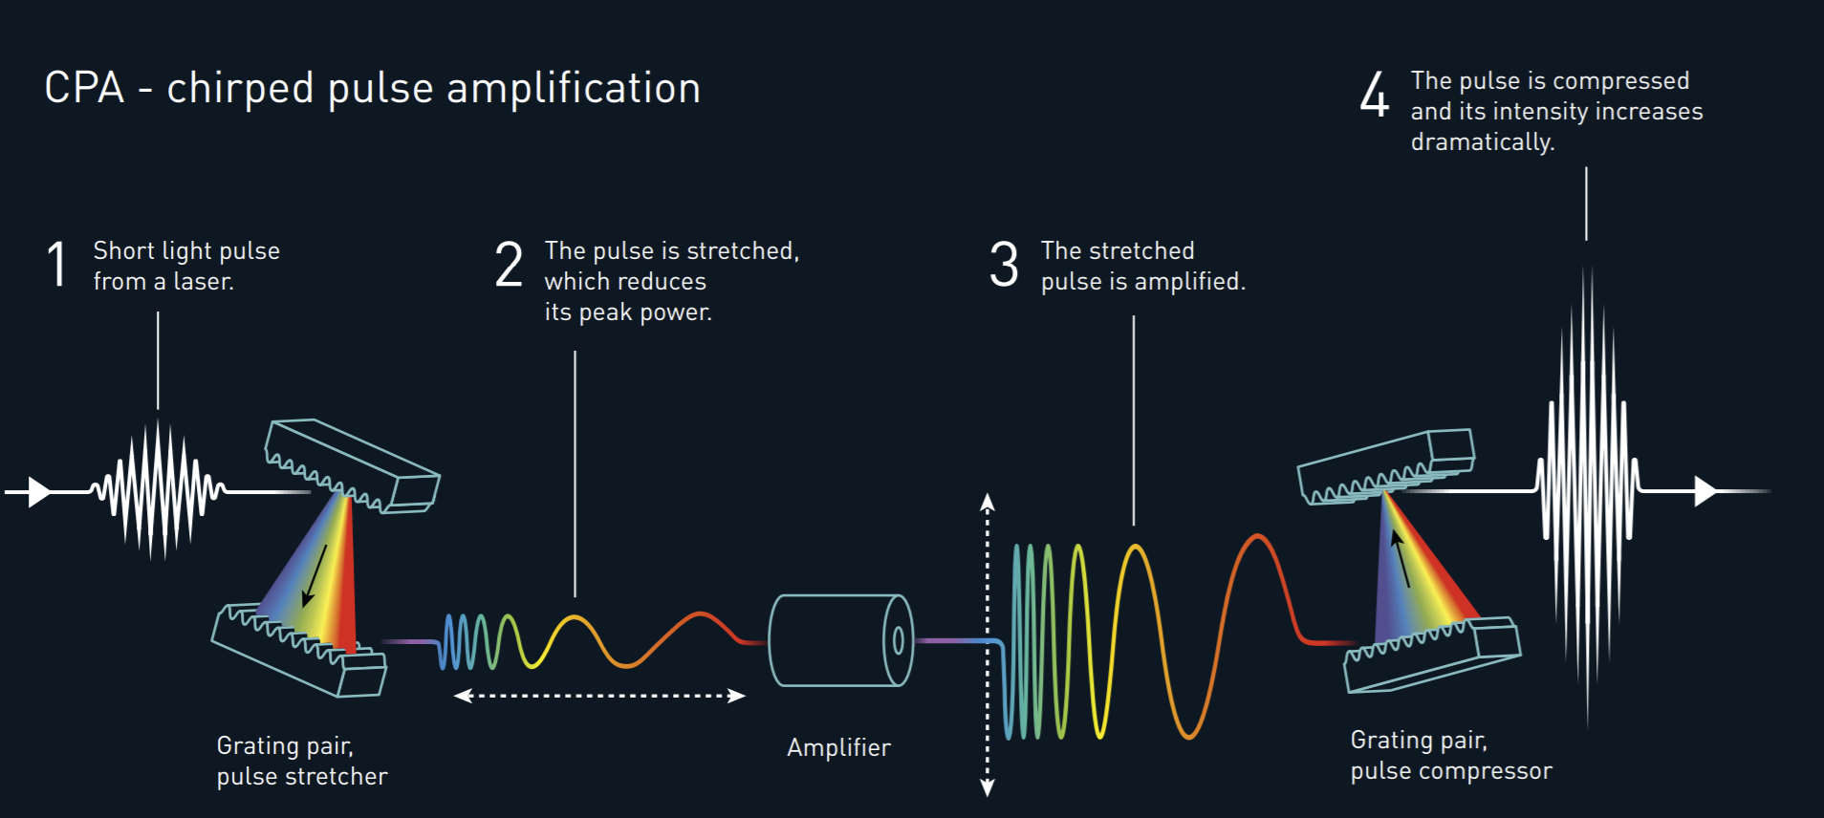
Ultrashort Laser Pulses
Ultrashort laser pulses are characterized by their pulse duration Δt and bandwidth Δω
Great effort has been made to reduce the pulse duration, enabling new observations
Modern CPA laser systems can directly produce laser pulses that have a pulse duration as small as a few femtoseconds (10⁻¹⁵ s)
To get beyond this, high-harmonic generation can be used to generate attosecond pulses

Slide 7
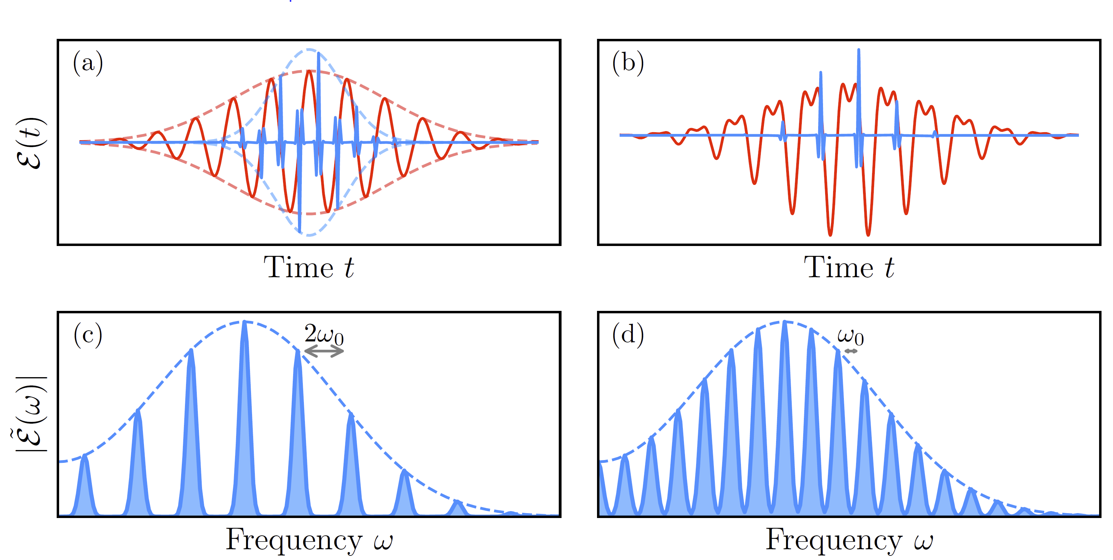
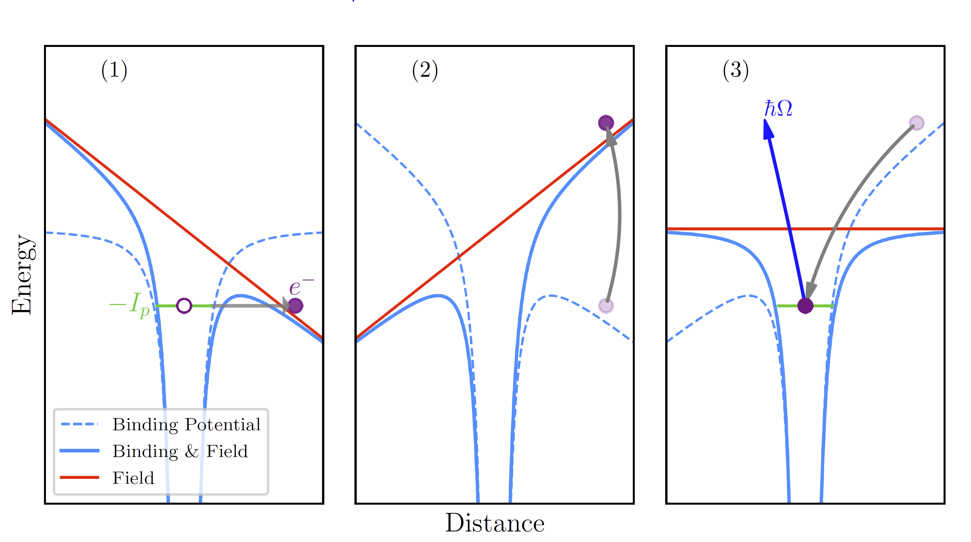
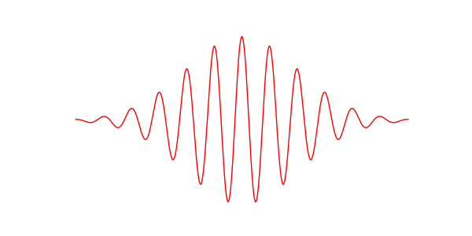
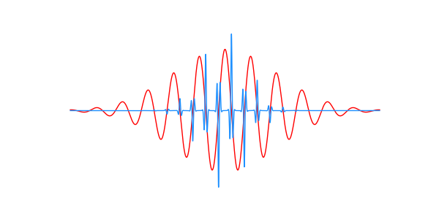
Introduction to high-harmonic generation (HHG)
Ionization
Propagation
Recombination
HHG can be used to generate pulses with bandwidth in the XUV (up to hundreds of eV)
Describe by a 3-step model
Naturally produces an attosecond pulse train (APT)
Characterized by odd harmonics of the fundamental in the frequency domain
Gas
IR
XUV

Slide 8
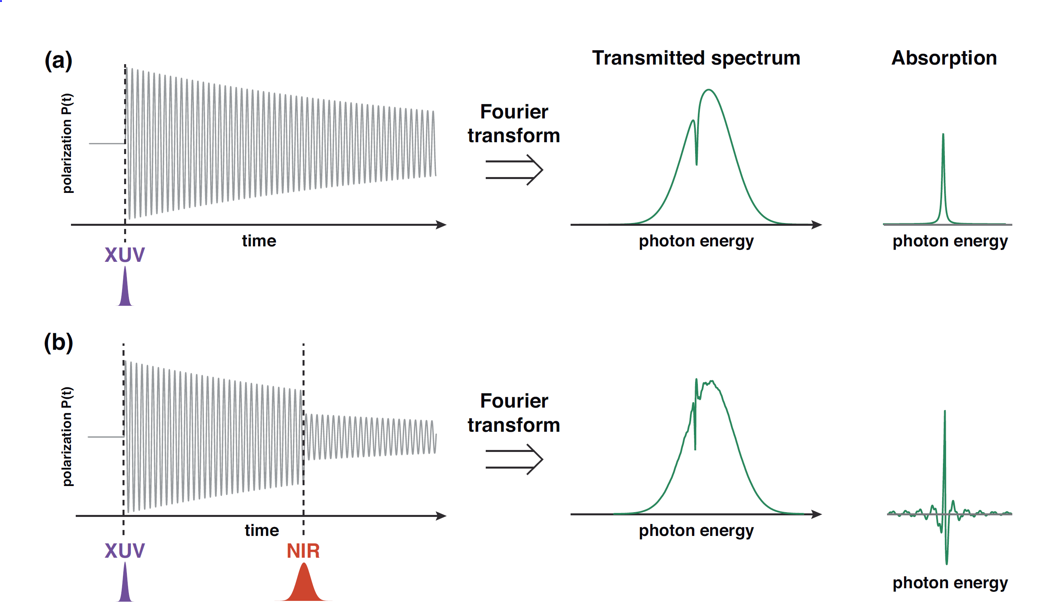
Attosecond transient absorption spectroscopy (ATS)
XUV induces a polarization in a gas medium
Polarization is macroscopic sum of oscillating dipoles which emit light that interferes with transmitted XUV ➔ absorption feature
An additional pulse perturbs this polarization through interactions with sample ➔ modified absorption feature
By measuring the delay dependent absorption, dynamics can be extracted

Slide 9
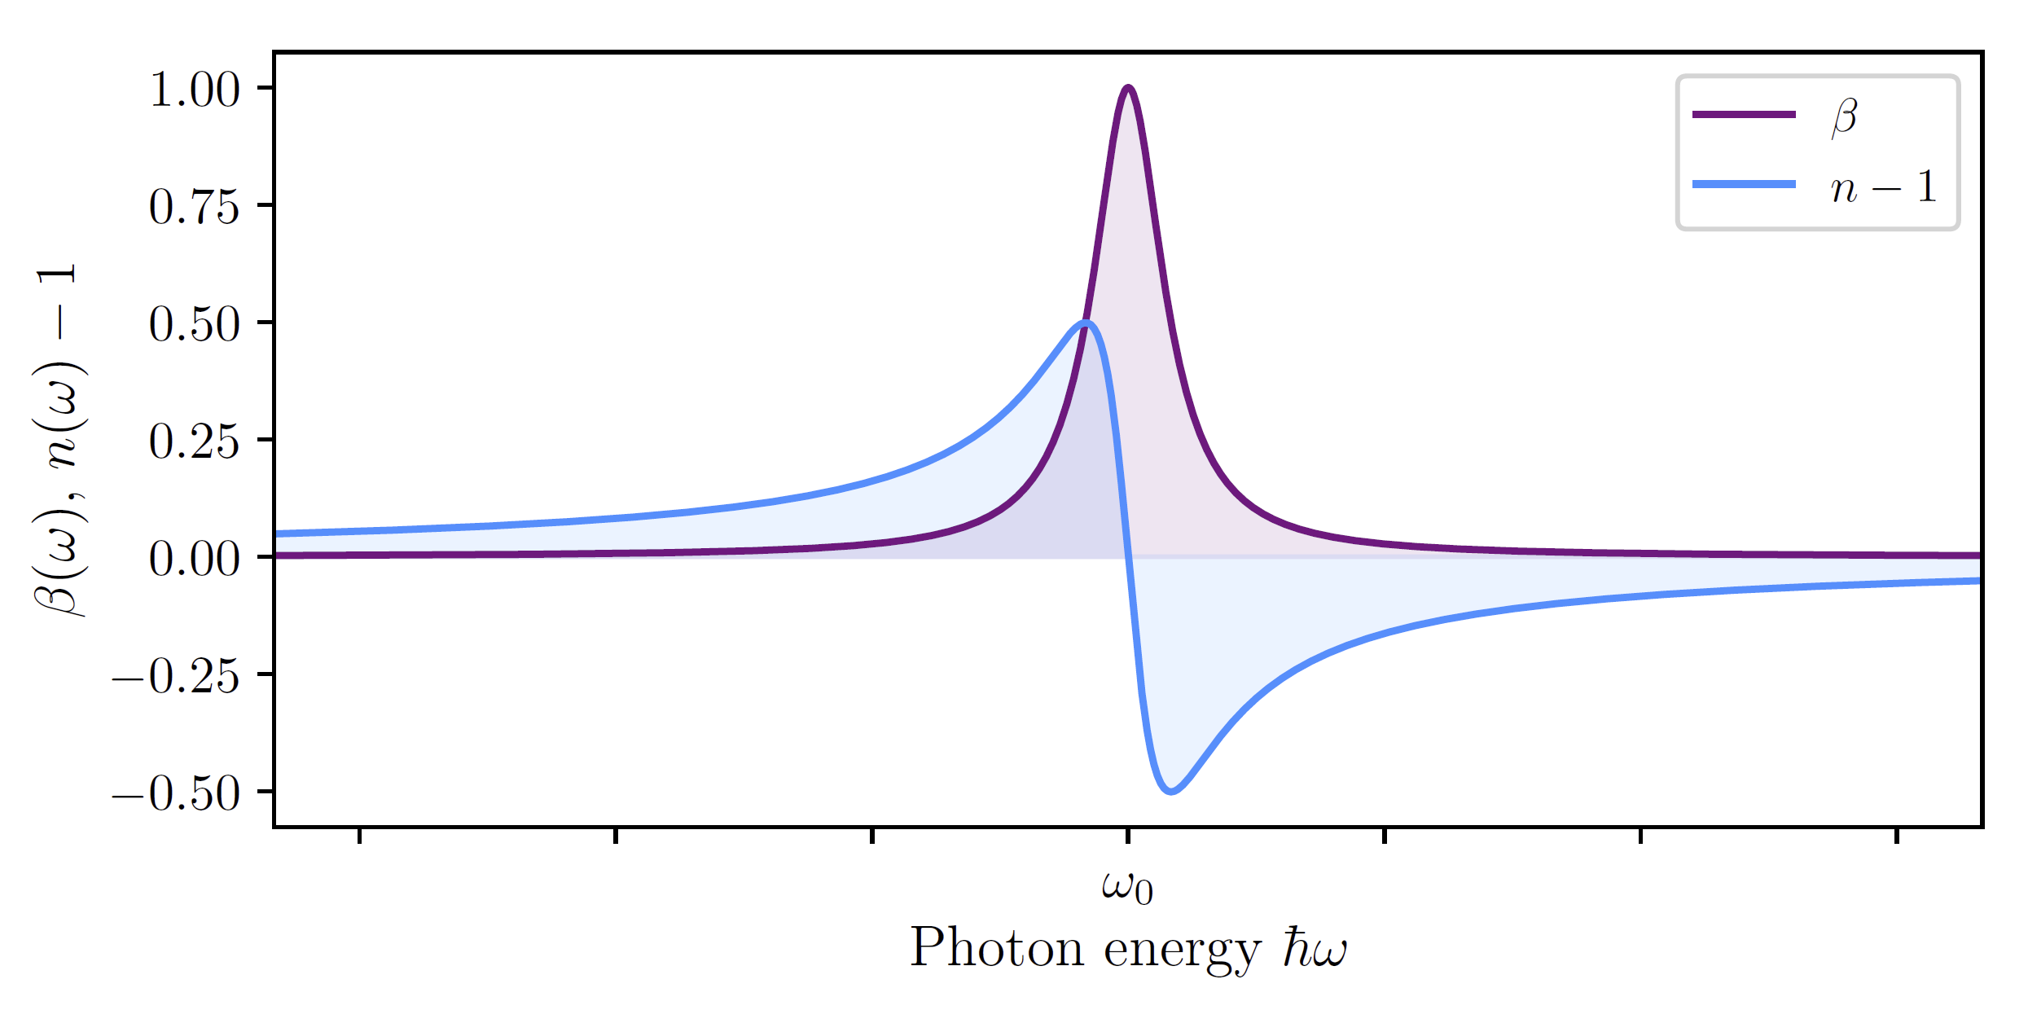
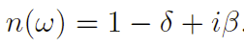
Complex attosecond transient-absorption spectroscopy (CATS)
Change in absorption → ATS
Change in absorption & dispersion → CATS
Generally, absorption is accompanied by dispersion
Change in dispersion cannot be directly observed in ATS experiments → only available through indirect calculations
CATS can directly measure the change in dispersion by using a reference field

Slide 10
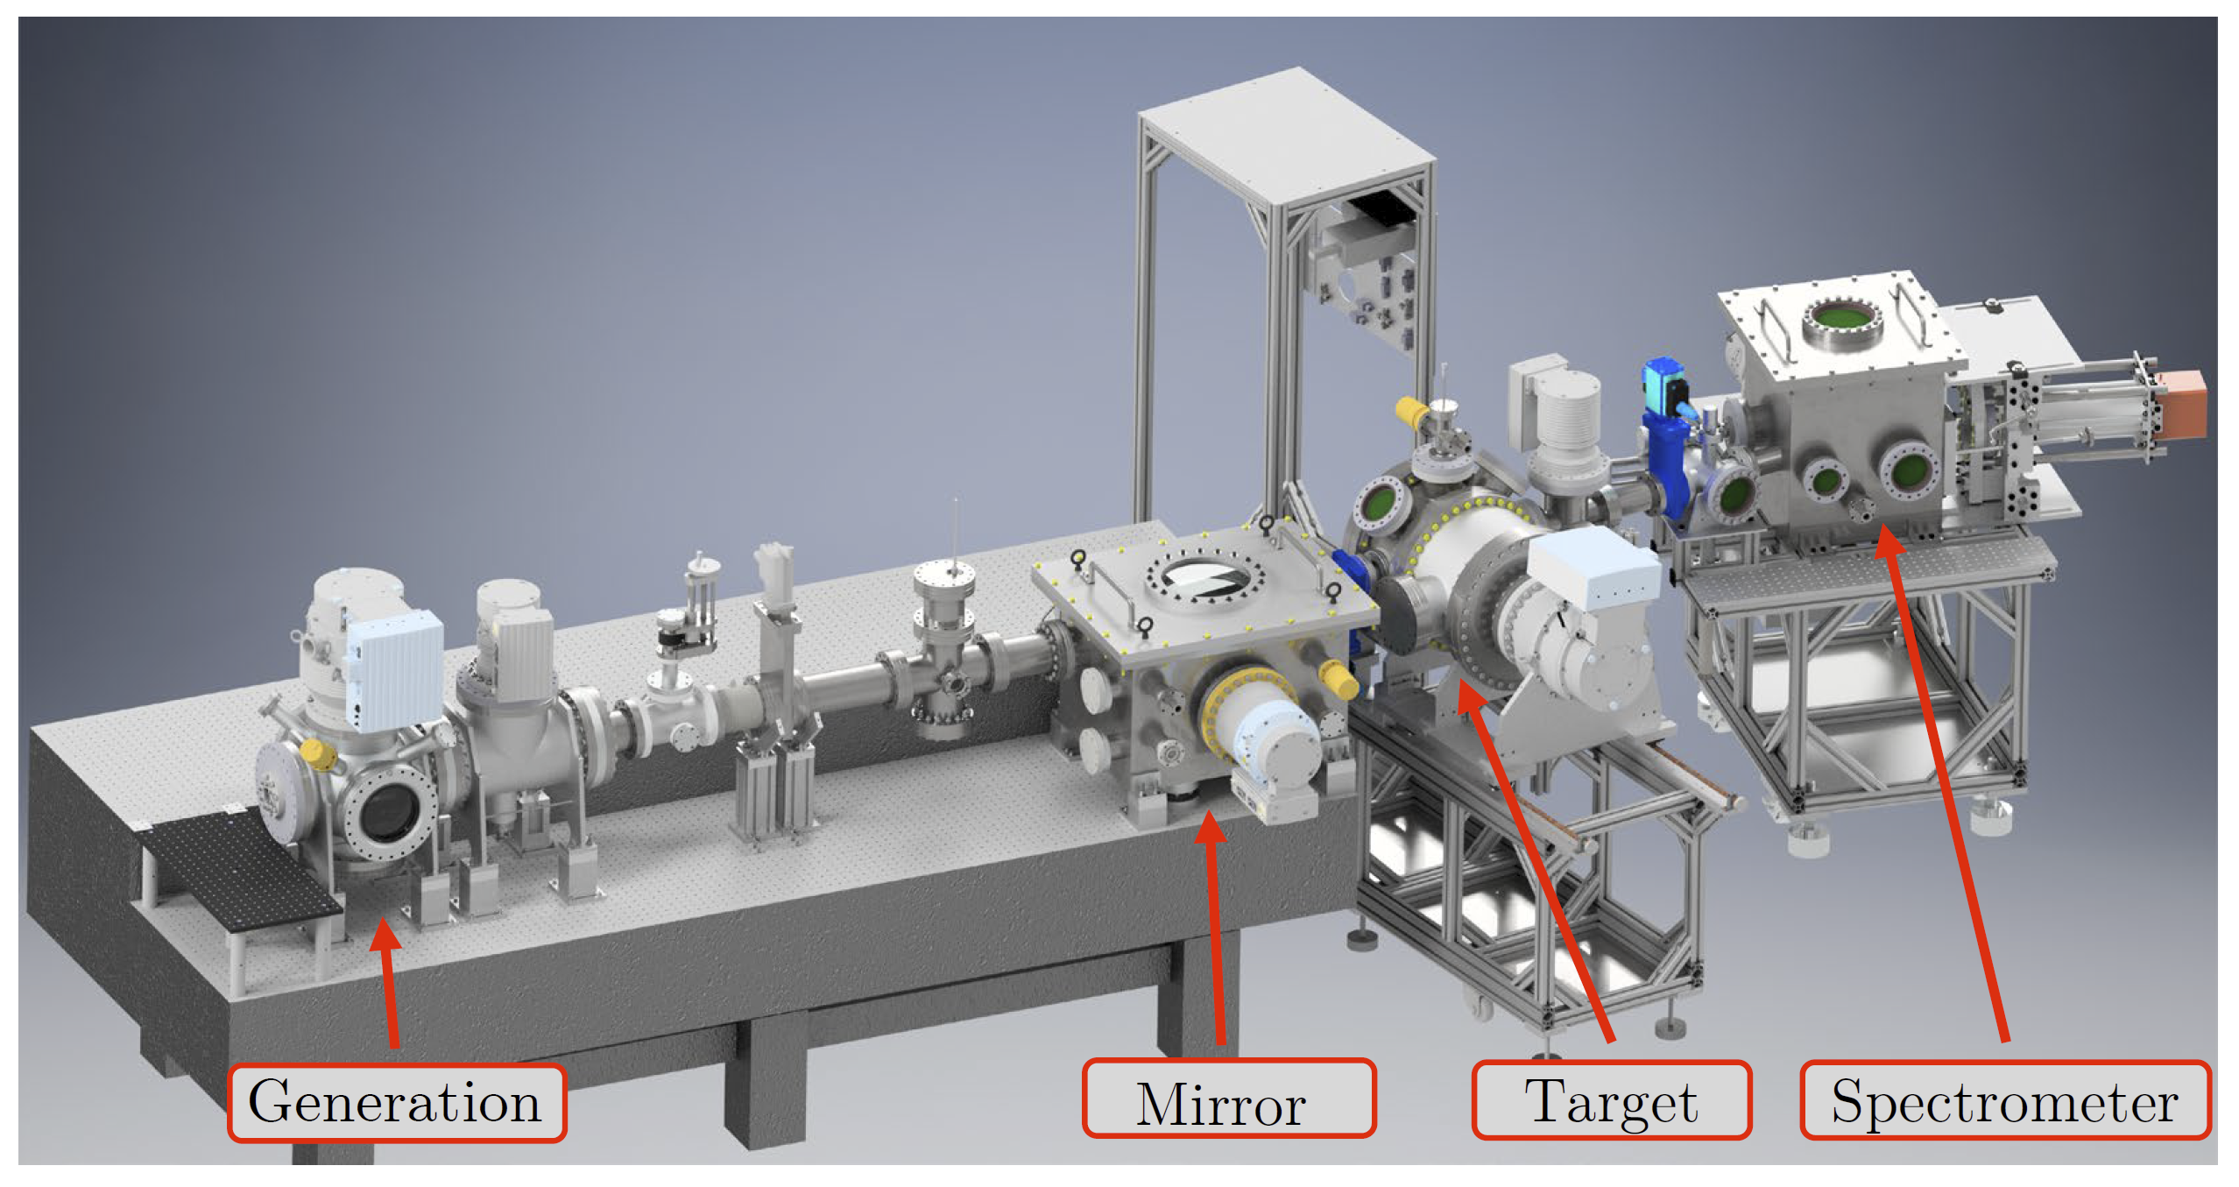
Transient Absorption Beamline (TABLe)

Slide 11
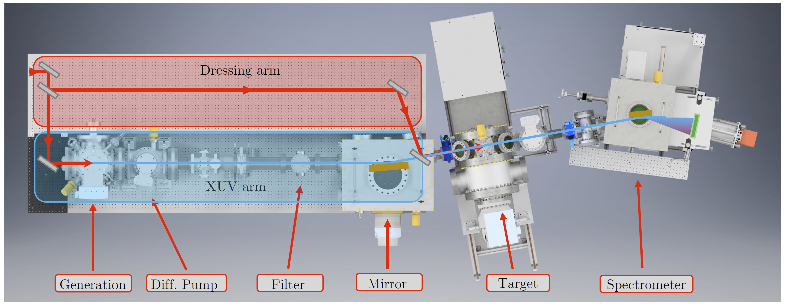
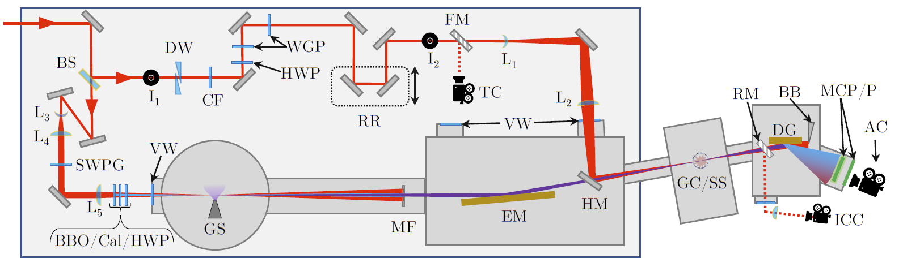
Transient Absorption Beamline (TABLe)
TOPAS
1300 – 1550 nm, 60 fs, 3 mJ, 1 kHz

Slide 12
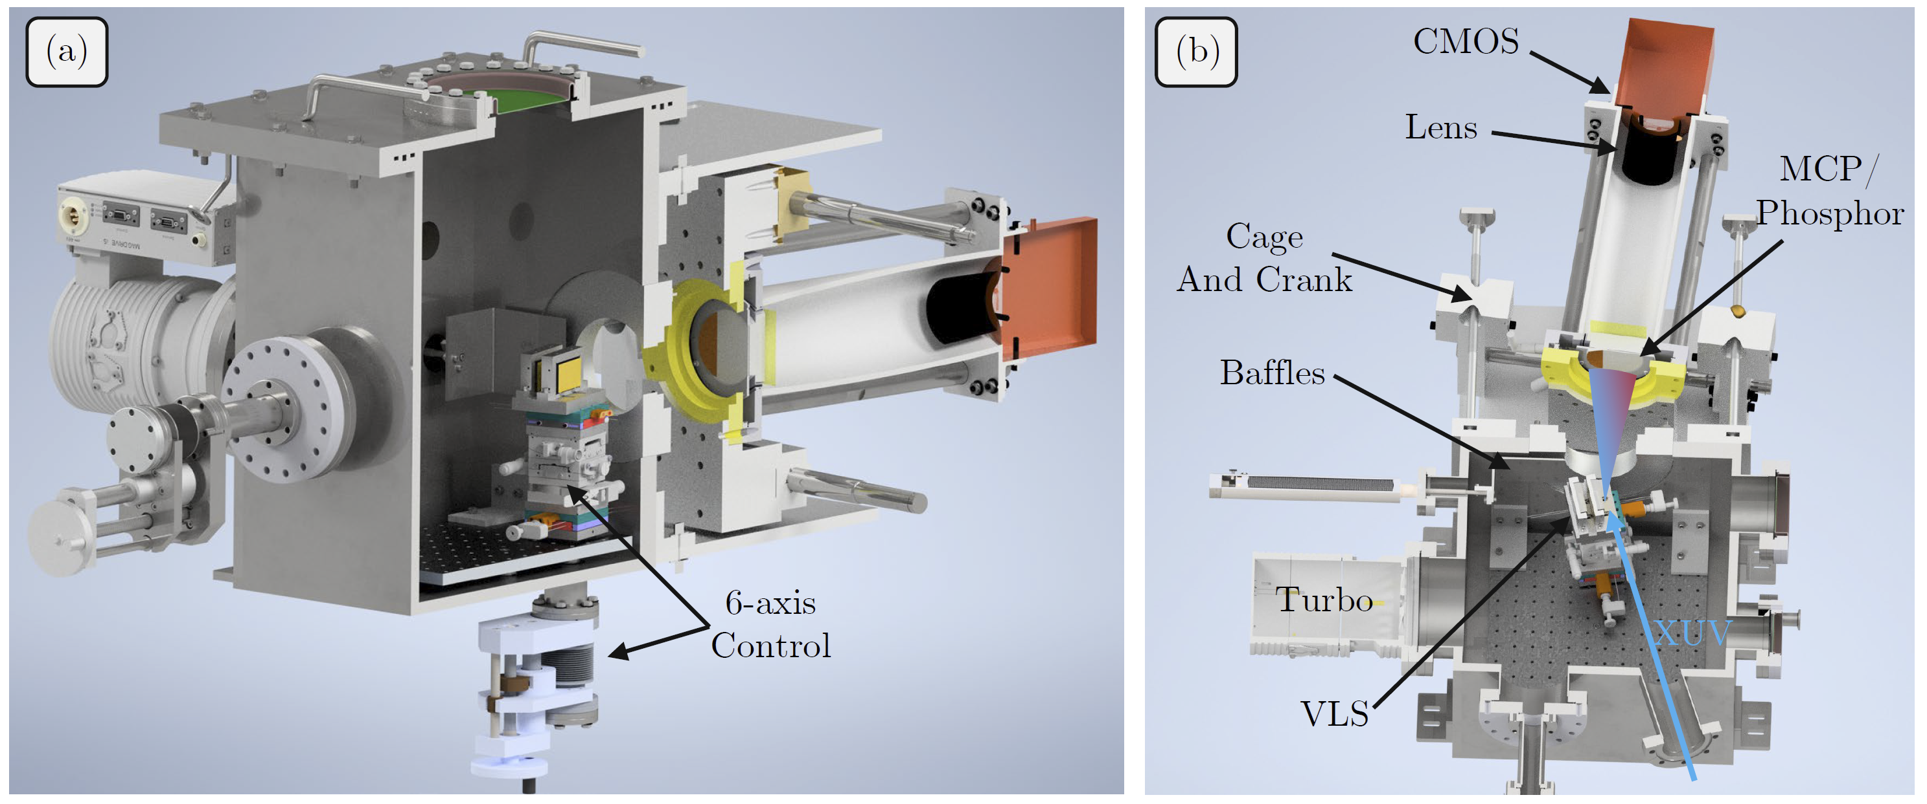
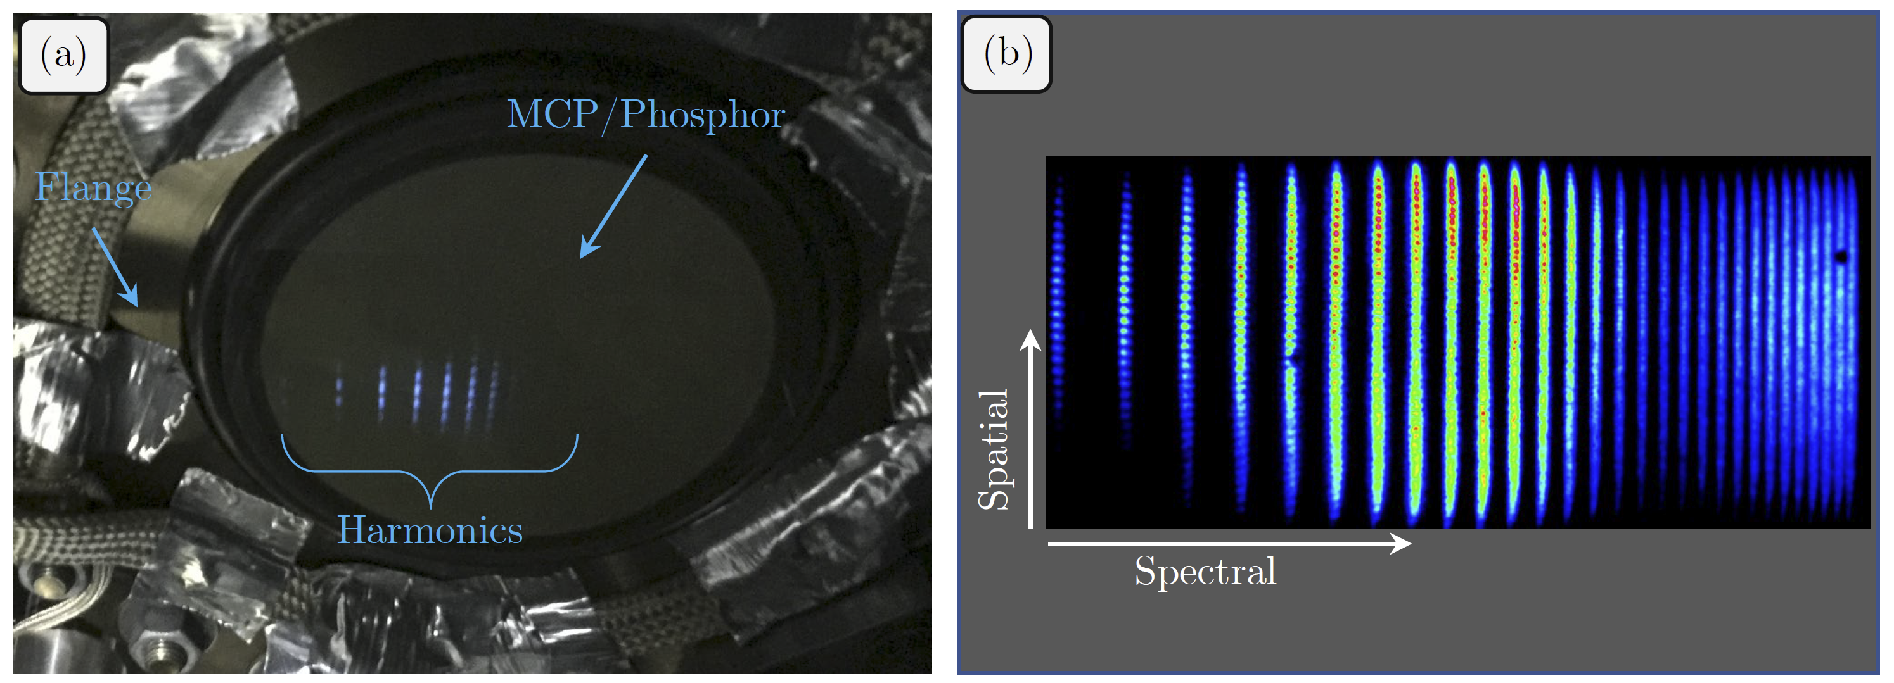
TABLe Photon Spectrometer
Photon spectrometer allows for the measurement of harmonics in the energy range 25-1240 eV using two VLS gratings
Cage and crank design allows for the MCP/phosphor detector to be positioned along the flat-field of both gratings
VLS grating only focus in one-dimension, thus the spatial profile can be measured as a function of photon energy

Slide 13
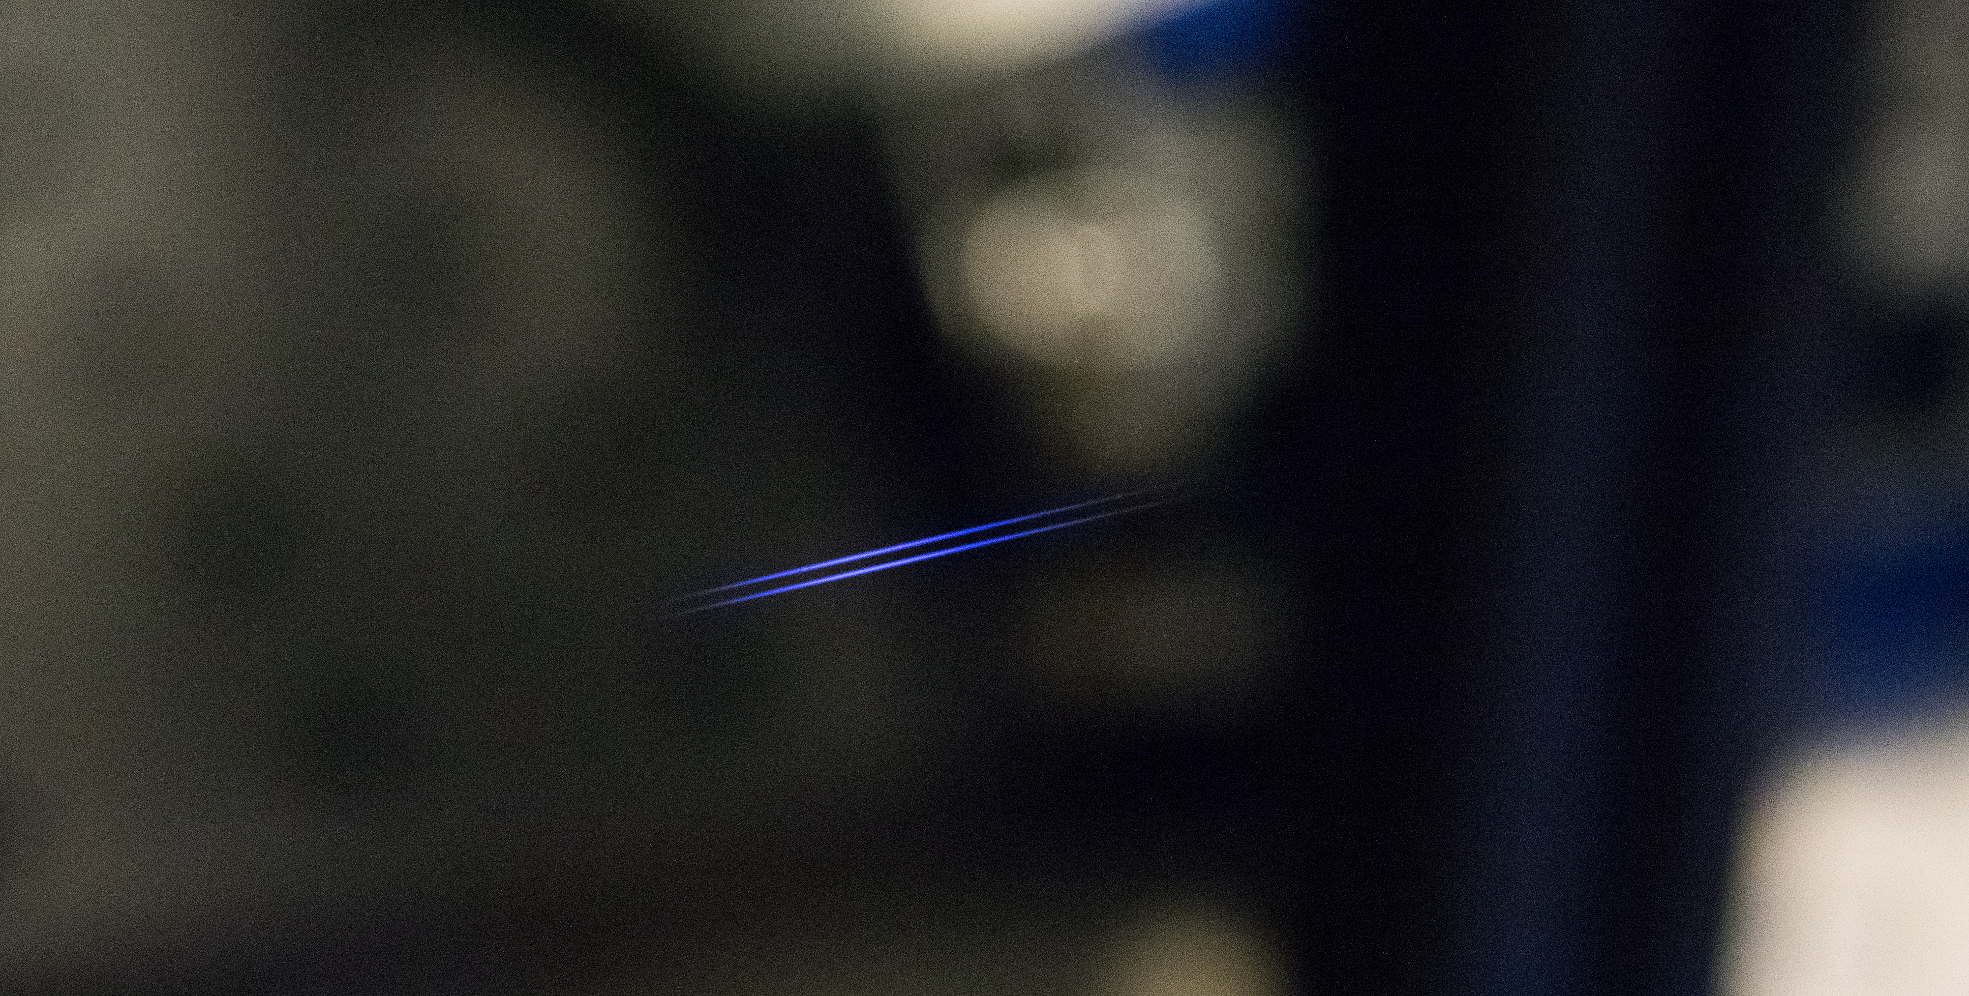

Slide 14
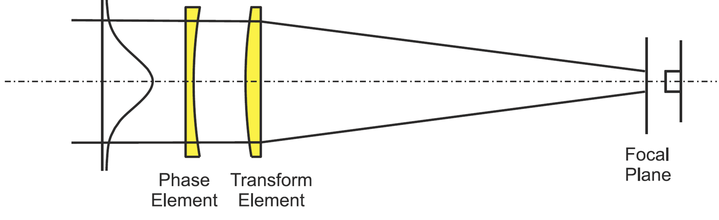
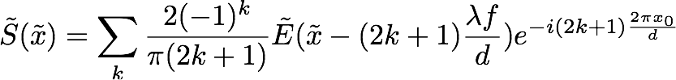
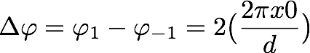
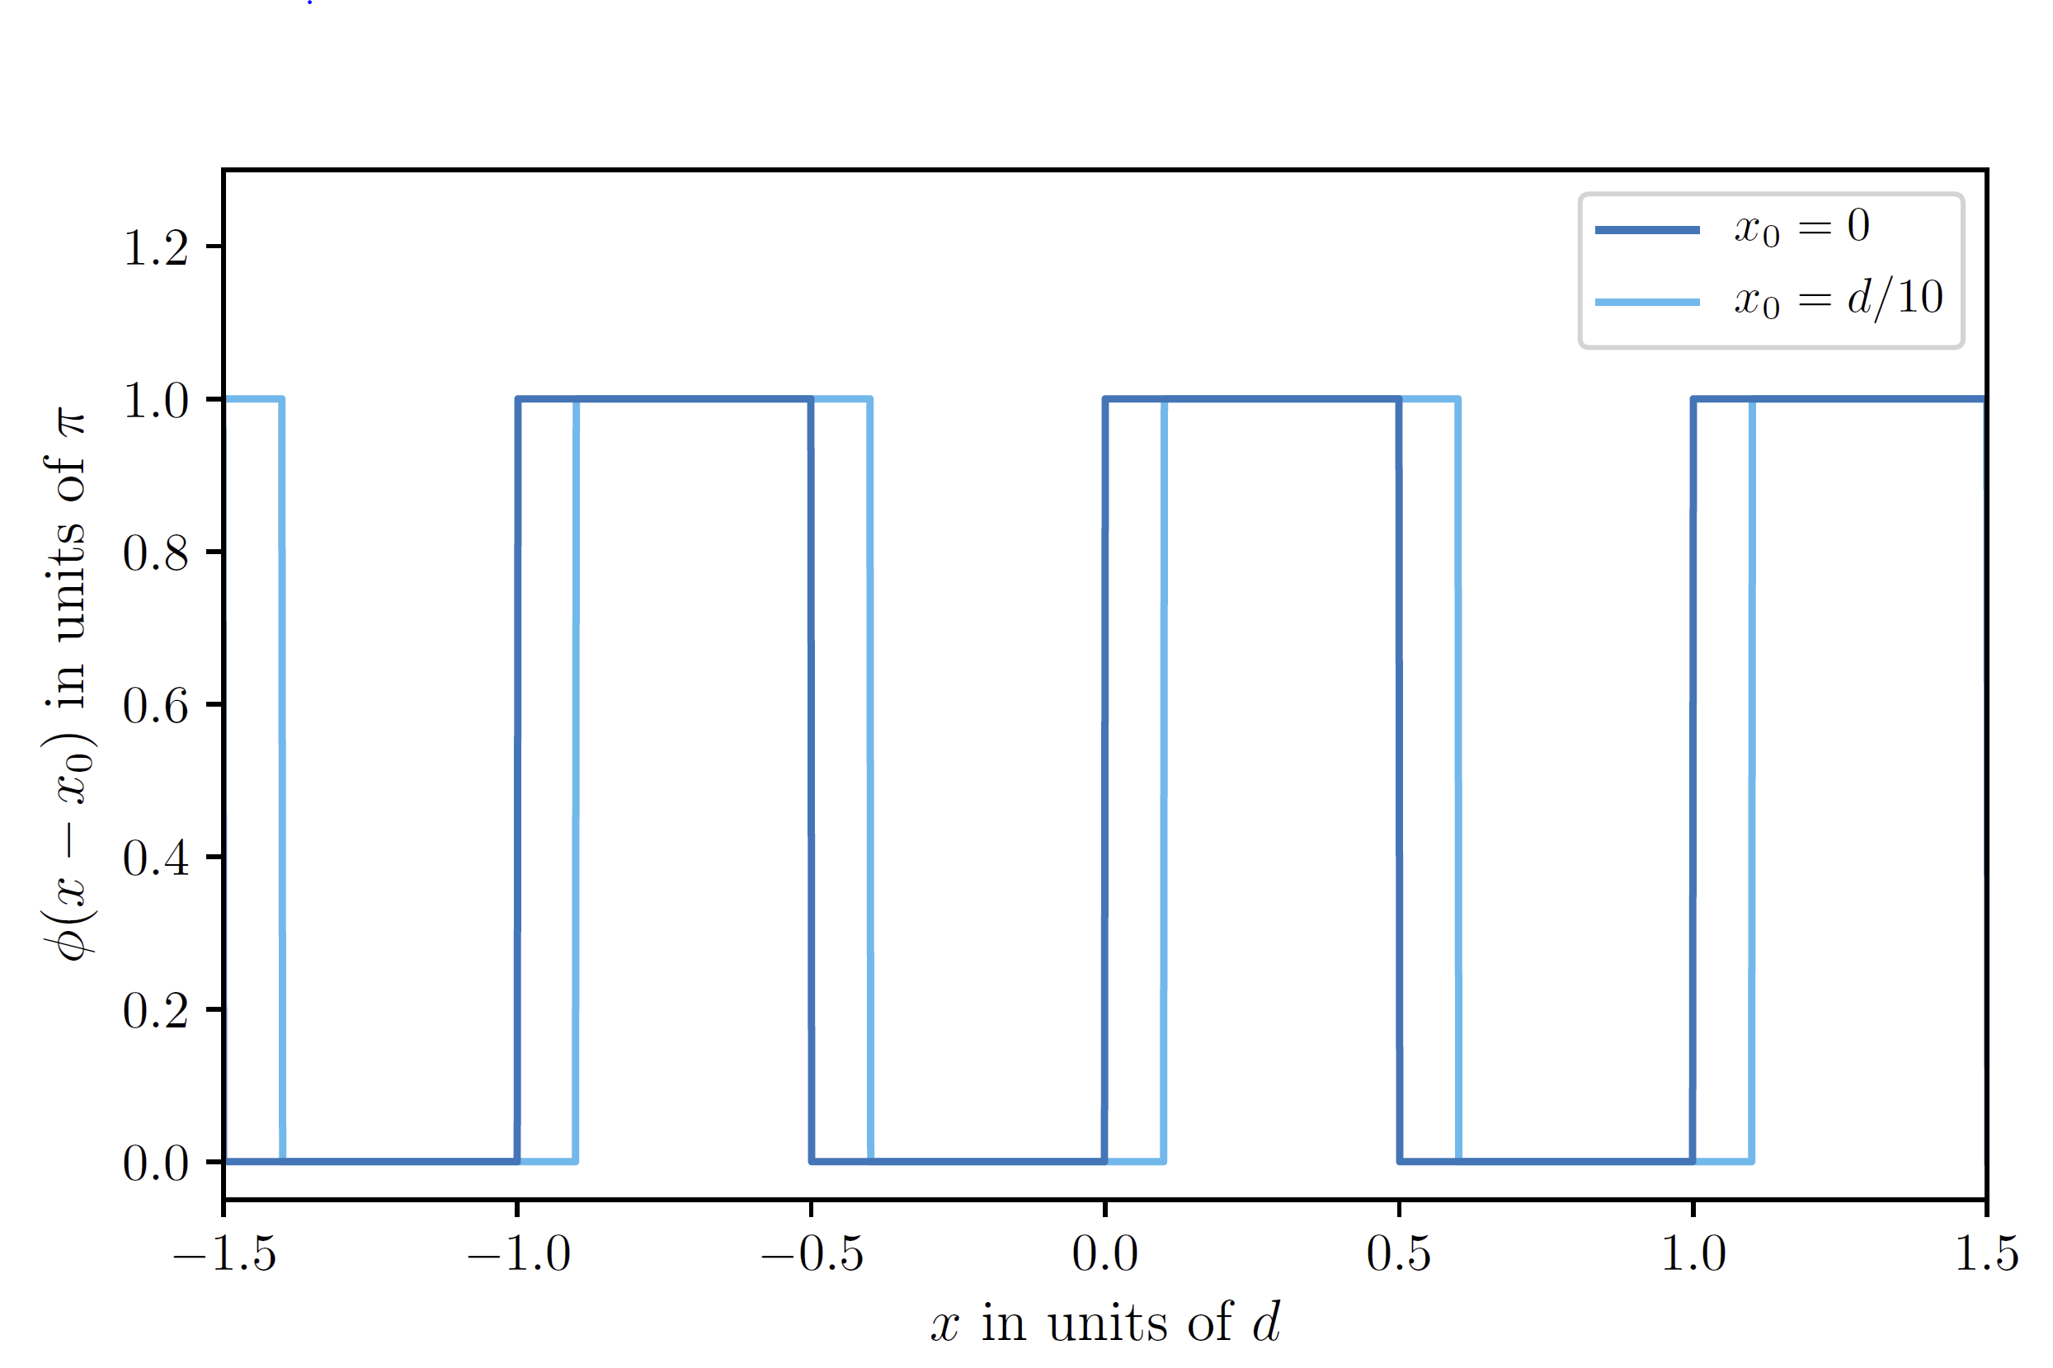
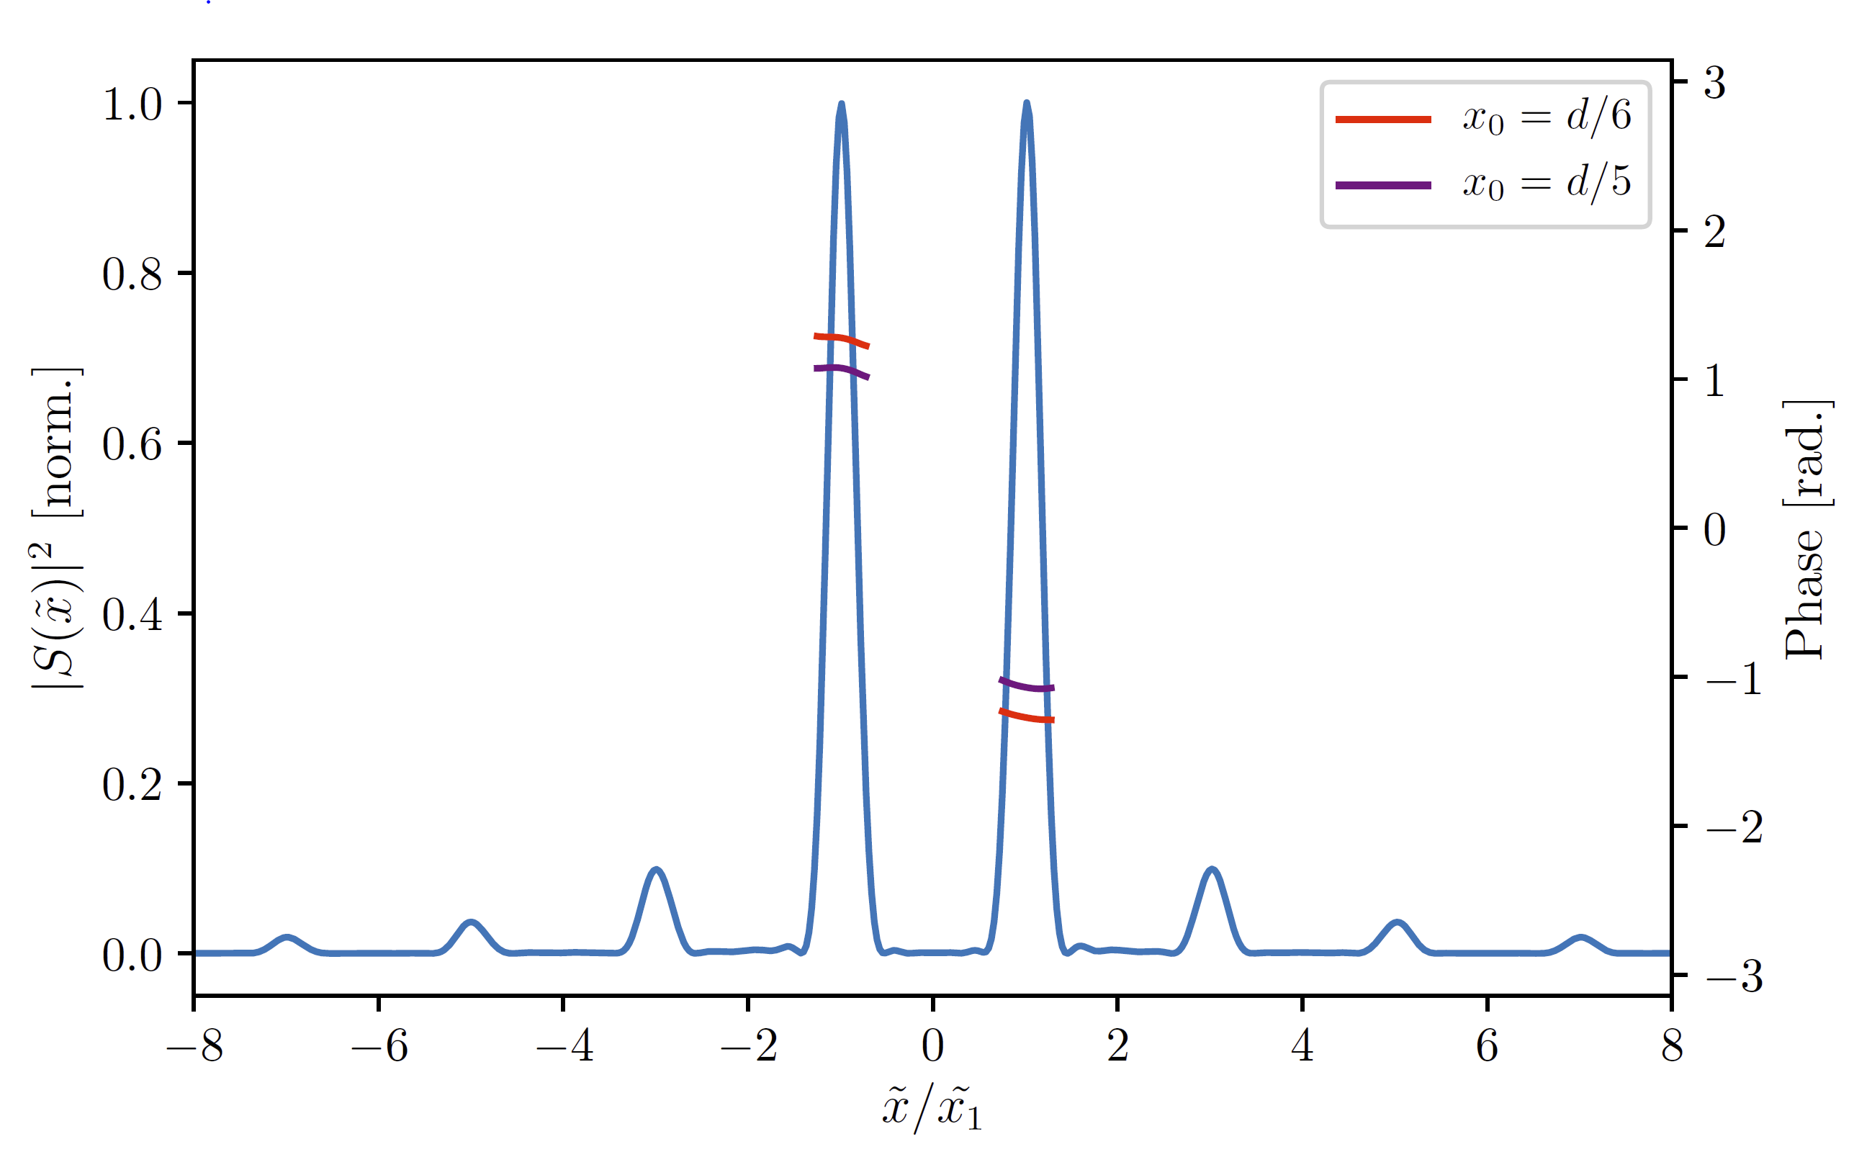
0-π Square-Wave Phase Grating (SWPG)
Field at the focus
Relative phase between ±1 orders
In order to perform CATS a reference field is needed → created using two-source HHG
Beam shaping is done using a square wave phase grating
This allows us to two create two duplicates of the input IR field, and each will generate XUV
The phase grating allows for high-precision control over the relative phase between the two sources

Slide 15
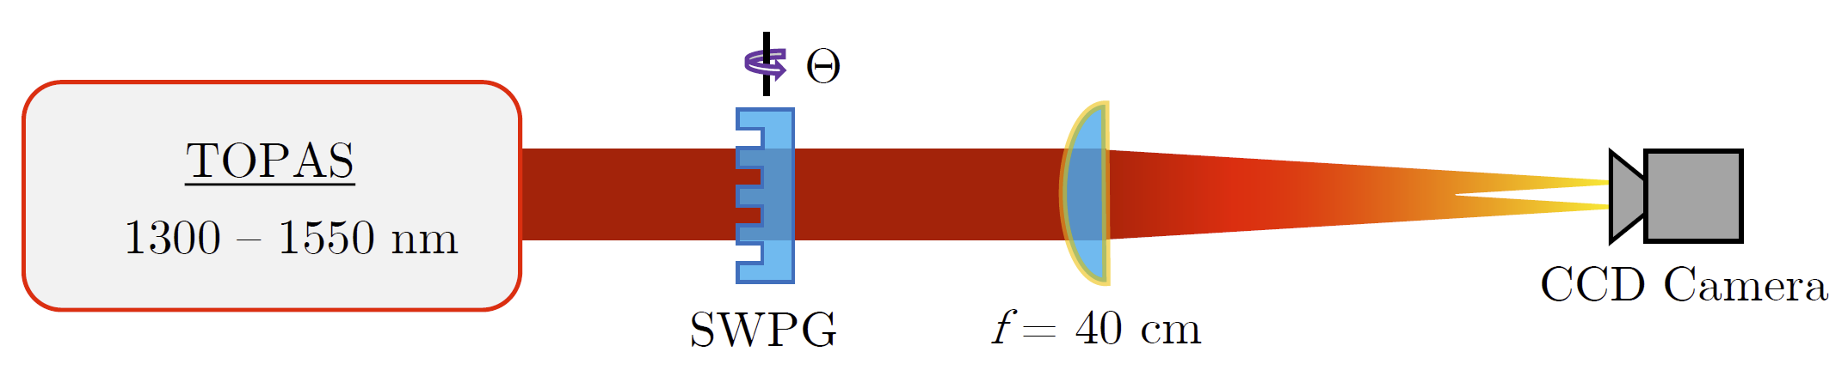
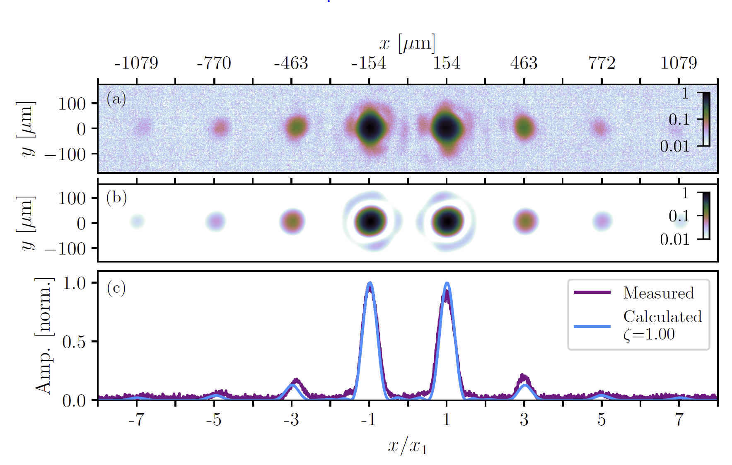
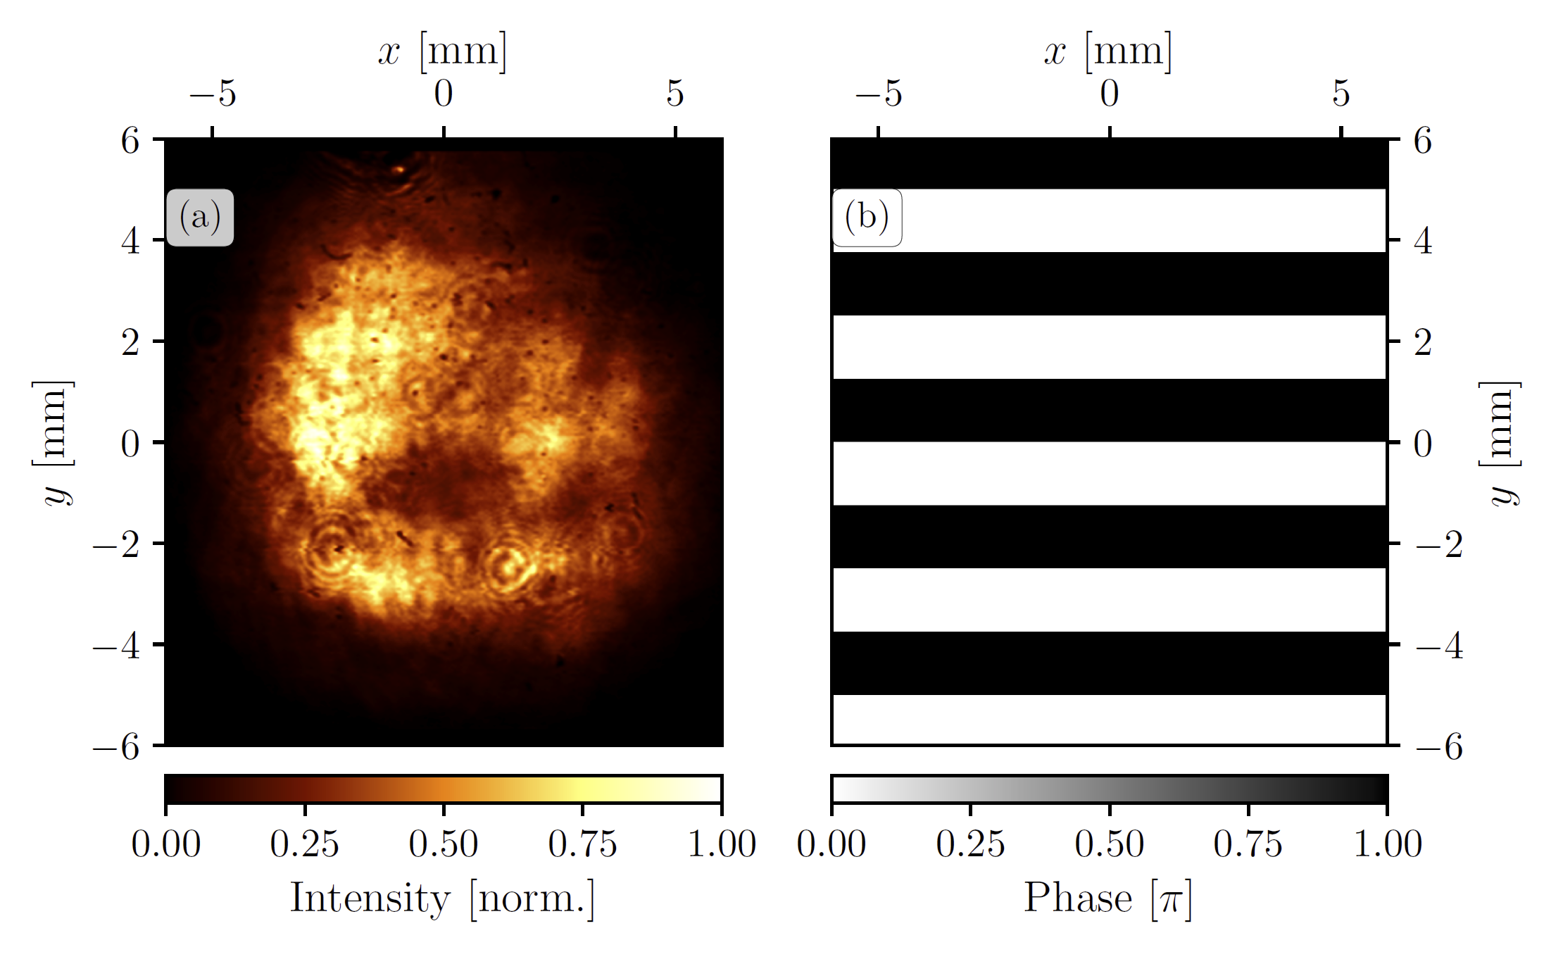
SWPG Beam Profile Measurement
Beam profile at the focal plane can be measured using a CCD camera
Shows excellent agreement between measured beam and the calculated
Demonstrates that the SWPG can be used as a “duplicator”
Only measures intensity, so relative phase control needs to be demonstrated in another way → HHG

Slide 16
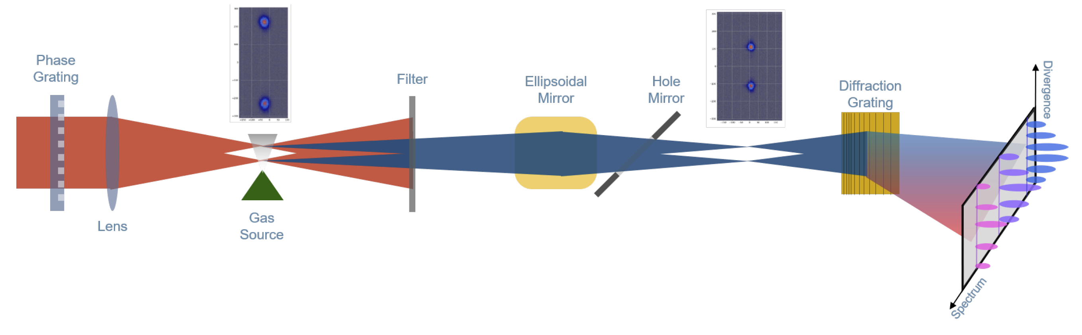
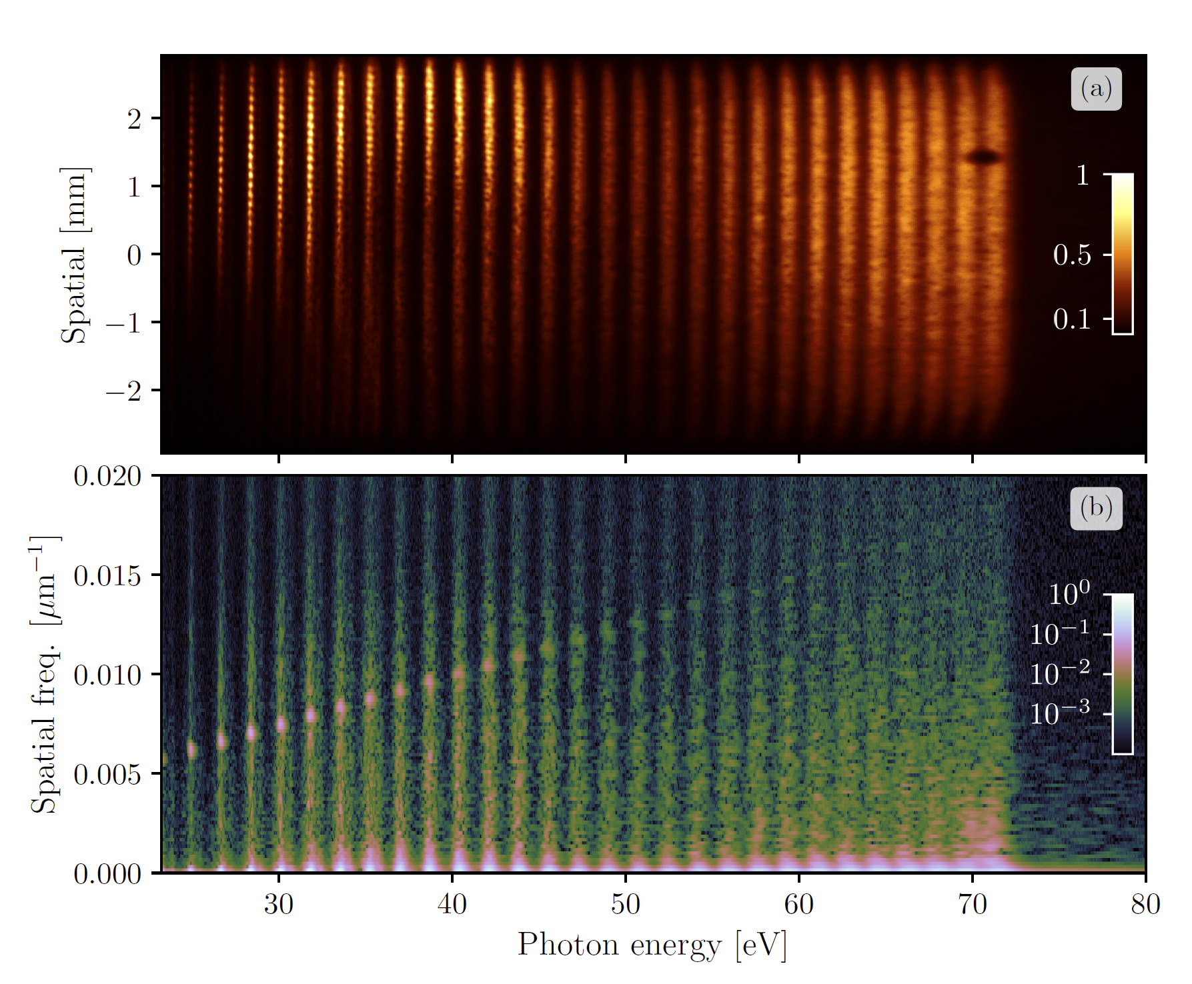
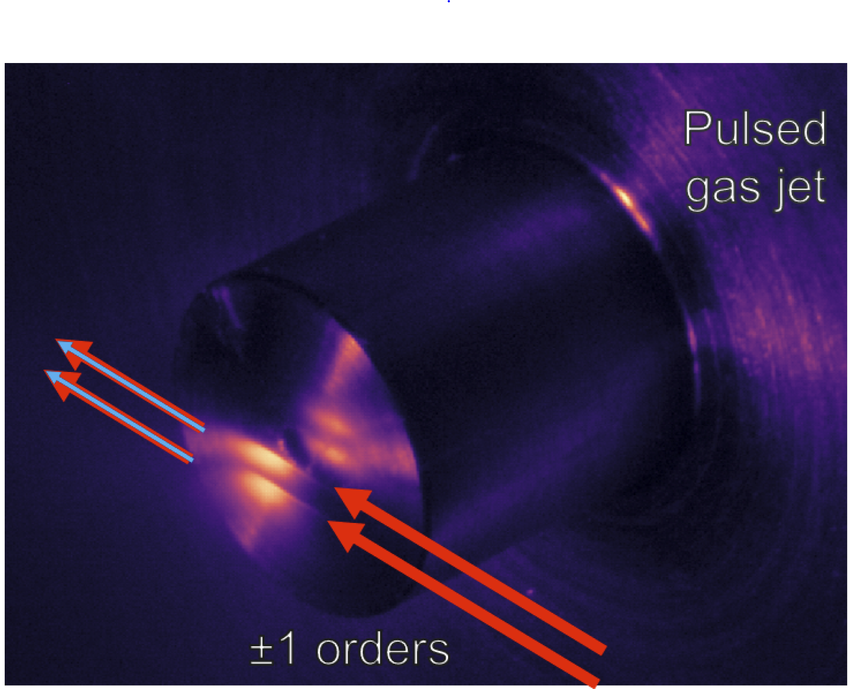
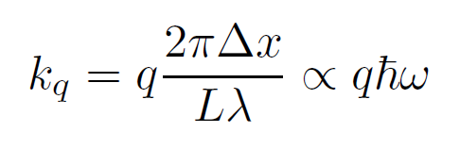
Two-source HHG

Slide 17
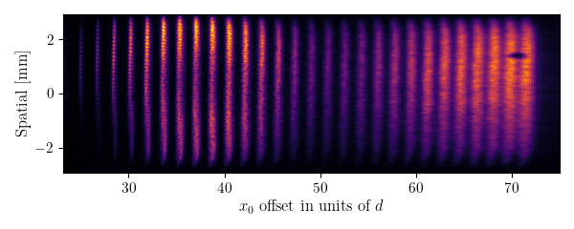
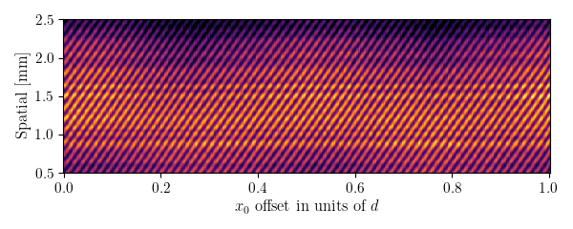
Relative phase control using SWPG
δφ
Phase shift
between sources
δφ
Fringe shift in
diffraction pattern
δx
Translation of grating
in transverse plane
spatialgram
SWPG creates what is essentially a single optic interferometer, which means that the interferometric stability is extremely high
This stability means that small phase shifts between the two sources can be measured as a fringe shift in the diffraction pattern
This can be seen in the spatial profile of the harmonic as the grating in translated through its full period → spatialgram

Slide 18
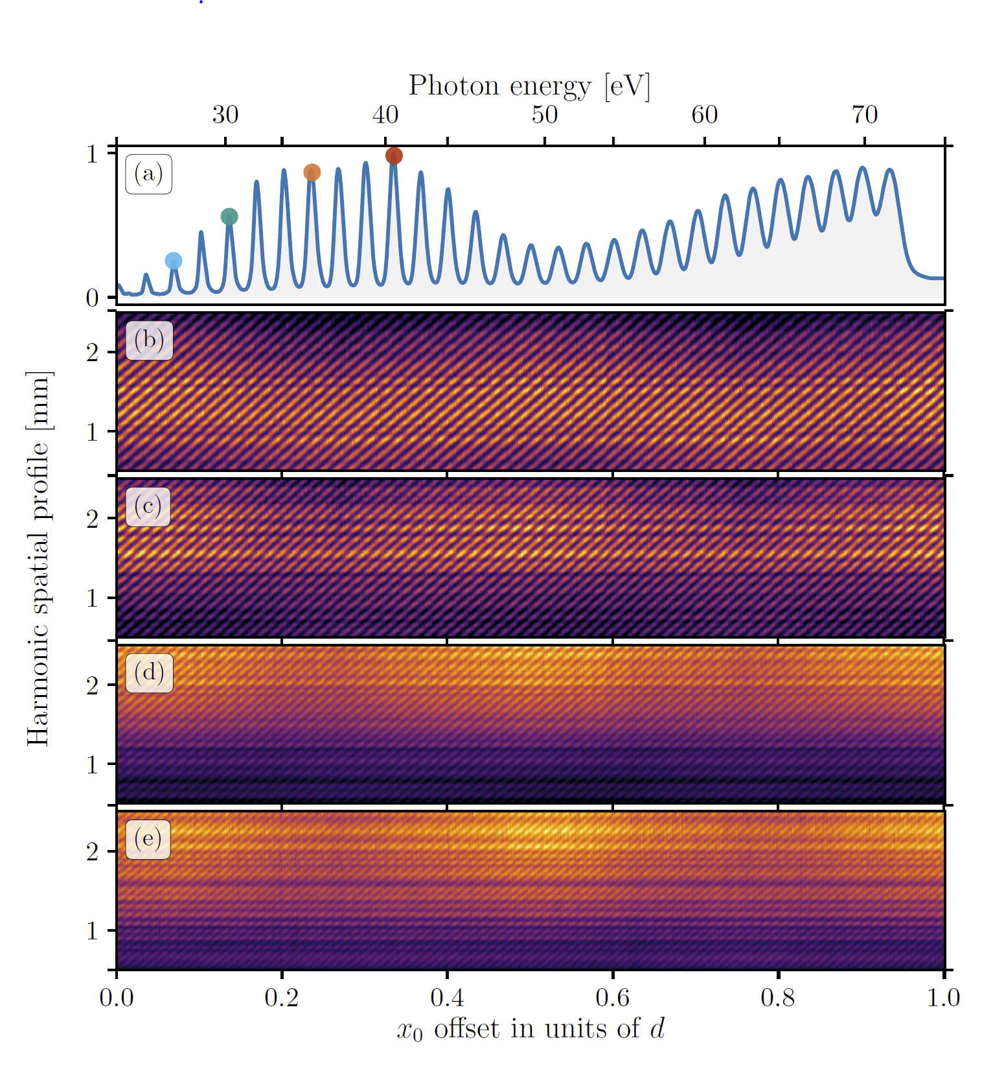
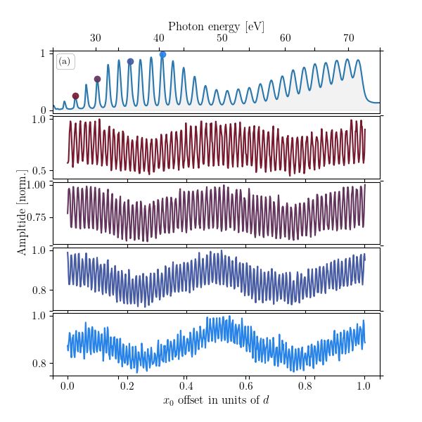
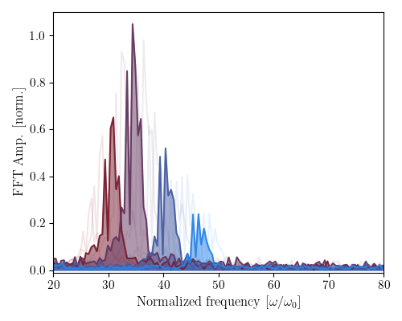
Relative phase control using SWPG
Spatialgrams can be measured for each harmonic order
Fourier transforming shows the dependence on harmonic order → allows for direct measurement of harmonic order q
Ability to measure the harmonic order q from the spatialgram verifies that the SWPG is able to control the phase difference between the two IR sources with a precision of a few mrad

Slide 19
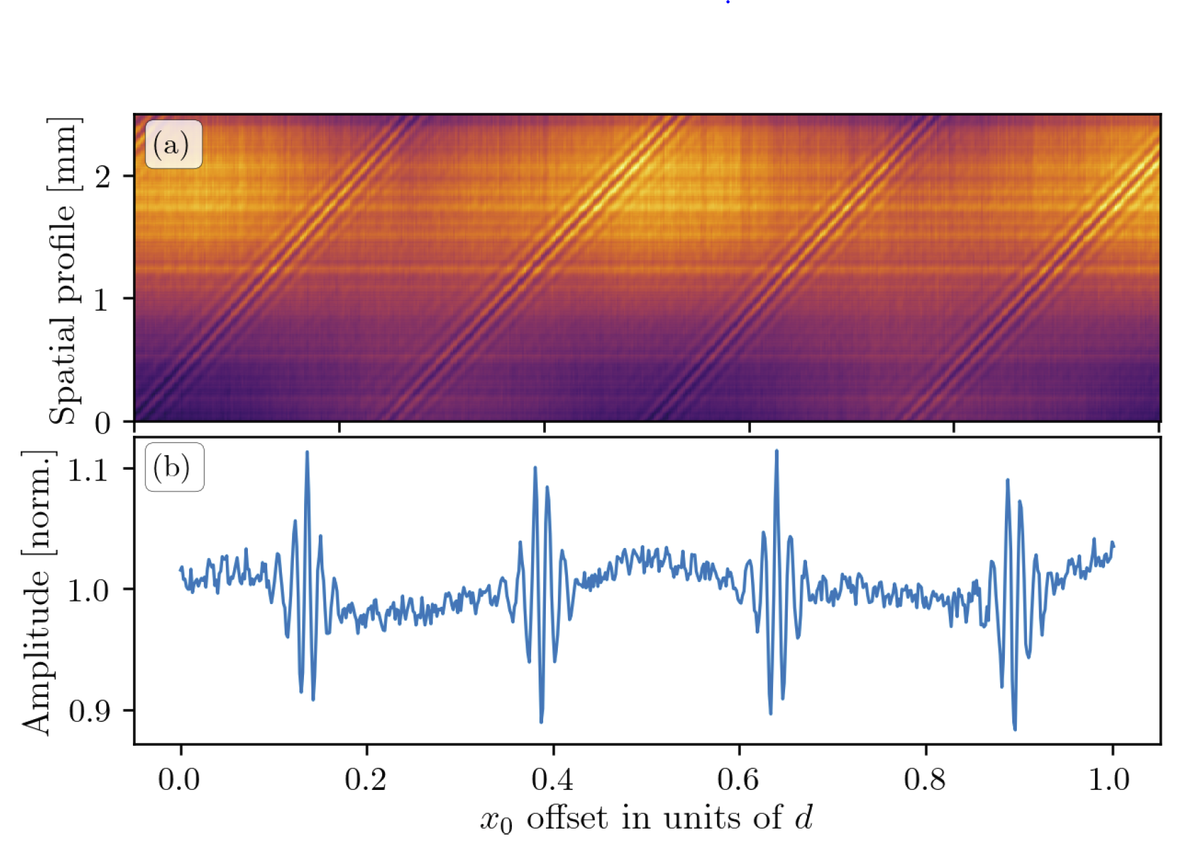
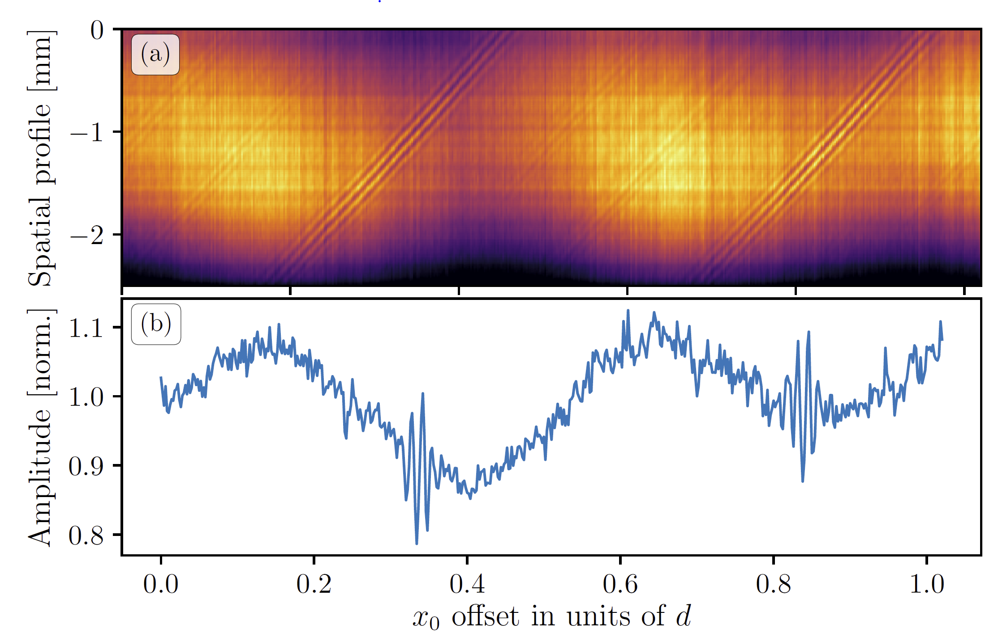
Interferometric autocorrelation using SWPG
Odd
Even/Odd
By combining all harmonics either numerically or by looking at the 0th order diffraction, one recovers the interferometric autocorrelation of the XUV APT
Symmetry of the APT can be seen clearly with one color and two color generation conditions
In principle, this enables one to do Fourier transform spectroscopy with a resolution of ω/2
Limited by interference between the two sources

Slide 20
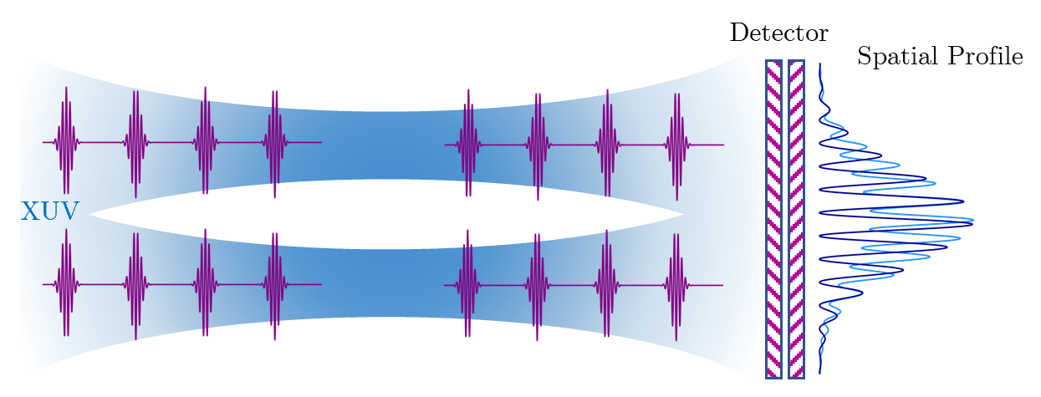
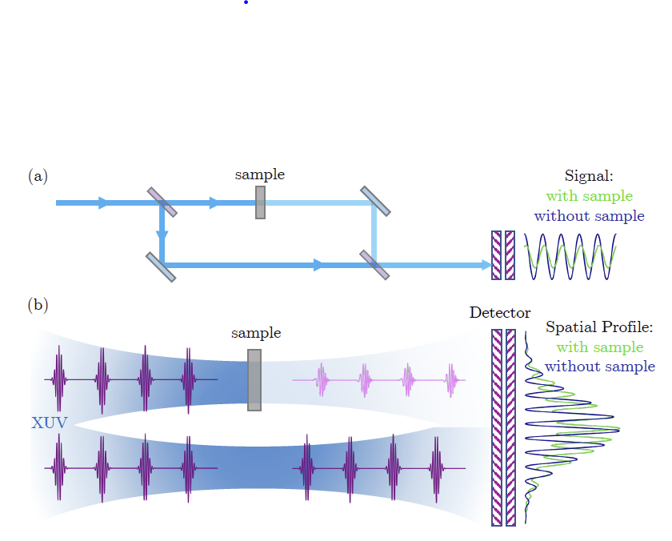
Two-source HHG using SWPG: conclusion and outlook
Conclusion
Demonstrated that the SWPG can be used duplicate an input beam and control the relative phase between the two main beams
Generating high-harmonics shows small phase shifts between the two sources can be measured as a fringe shift in the spatial profile of the harmonics
Outlook
SWPG acts as an inline interferometer with extremely high stability
Introducing a sample into one arm of this interferometer will cause a phase shift that will be imprinted upon the spatial profile
This can be used to measure the material properties of the sample

Slide 21
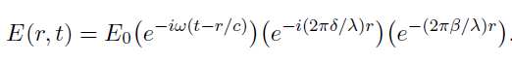
Complex refractive index
E_{in}
E_{out}
n(ω)
Complex refractive index describes the dispersion and absorption of light as it passes through a medium
Measuring both is difficult in the XUV/X-ray regime → one method is interferometric
Demonstrate how the SWPG “interferometer” can be used to measure both parts in the XUV regime

Slide 22
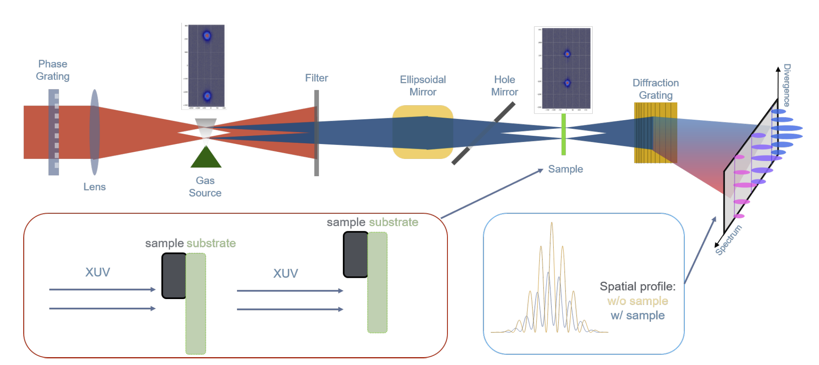
Experimental setup
SWPG was shown to be sensitive to phase shifts between the two sources → inline interferometer
Introducing a sample into only one source will lead to a change in fringe contrast and fringe shift

Slide 23
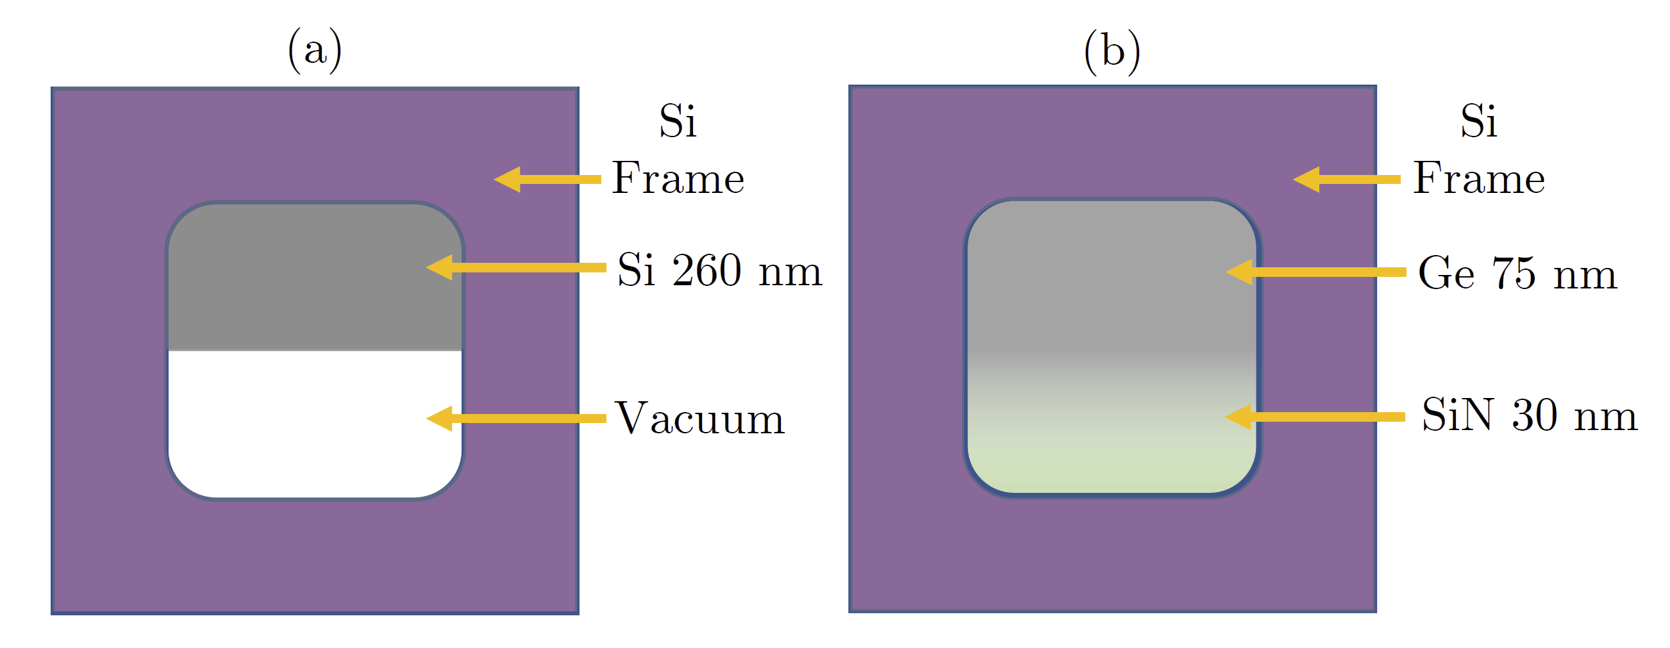
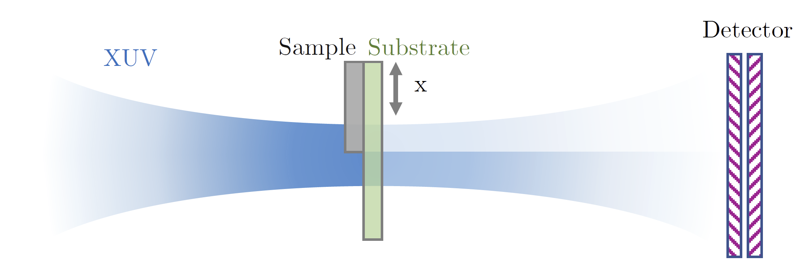
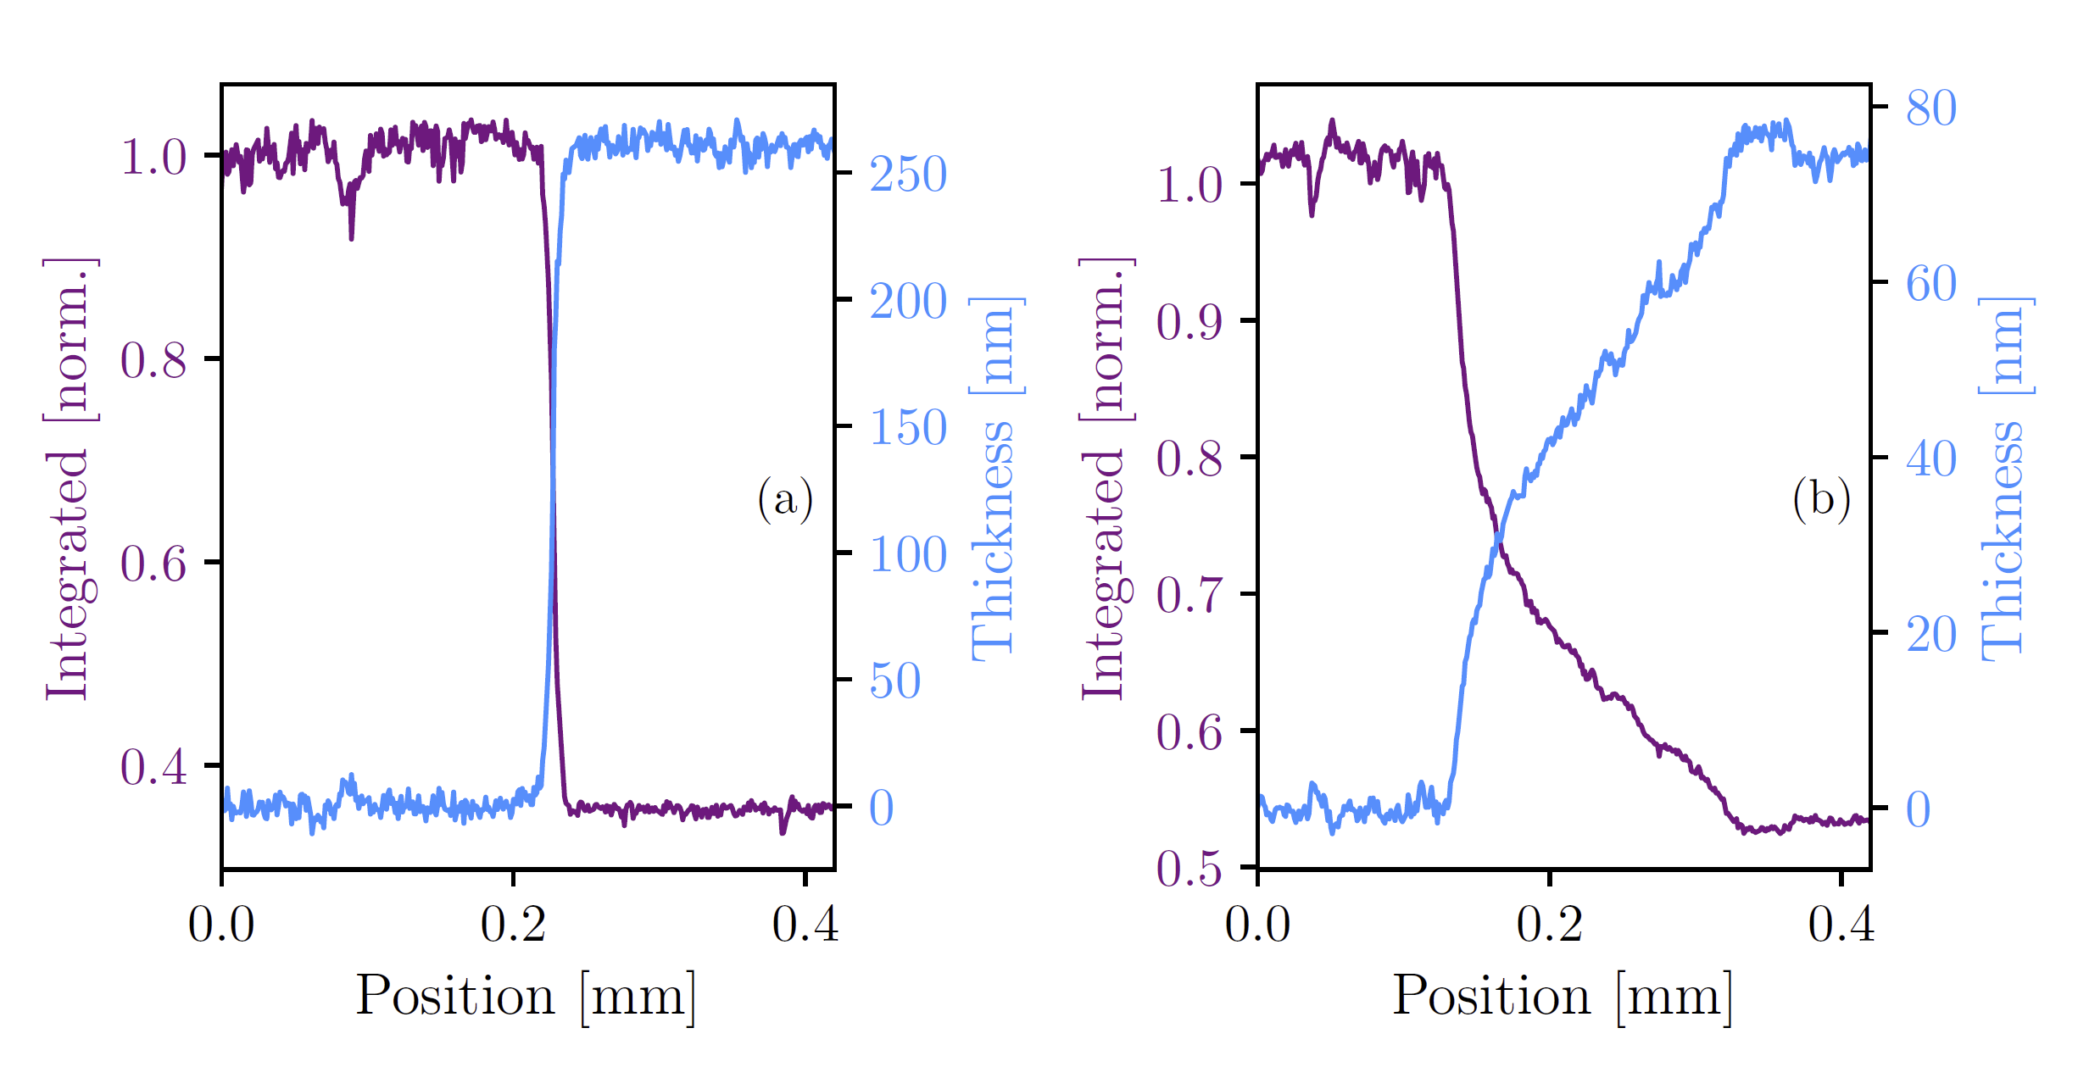
Silicon and germanium samples
Si
Ge
Sample must only go through one source → step-like profile
Needs to be free-standing or patterned on a free-standing membrane
Silicon sample is free standing and cleaved in half
Germanium sample was grown on SiN membrane
Knife-edge measurement can be used to measure the profile of each sample

Slide 24
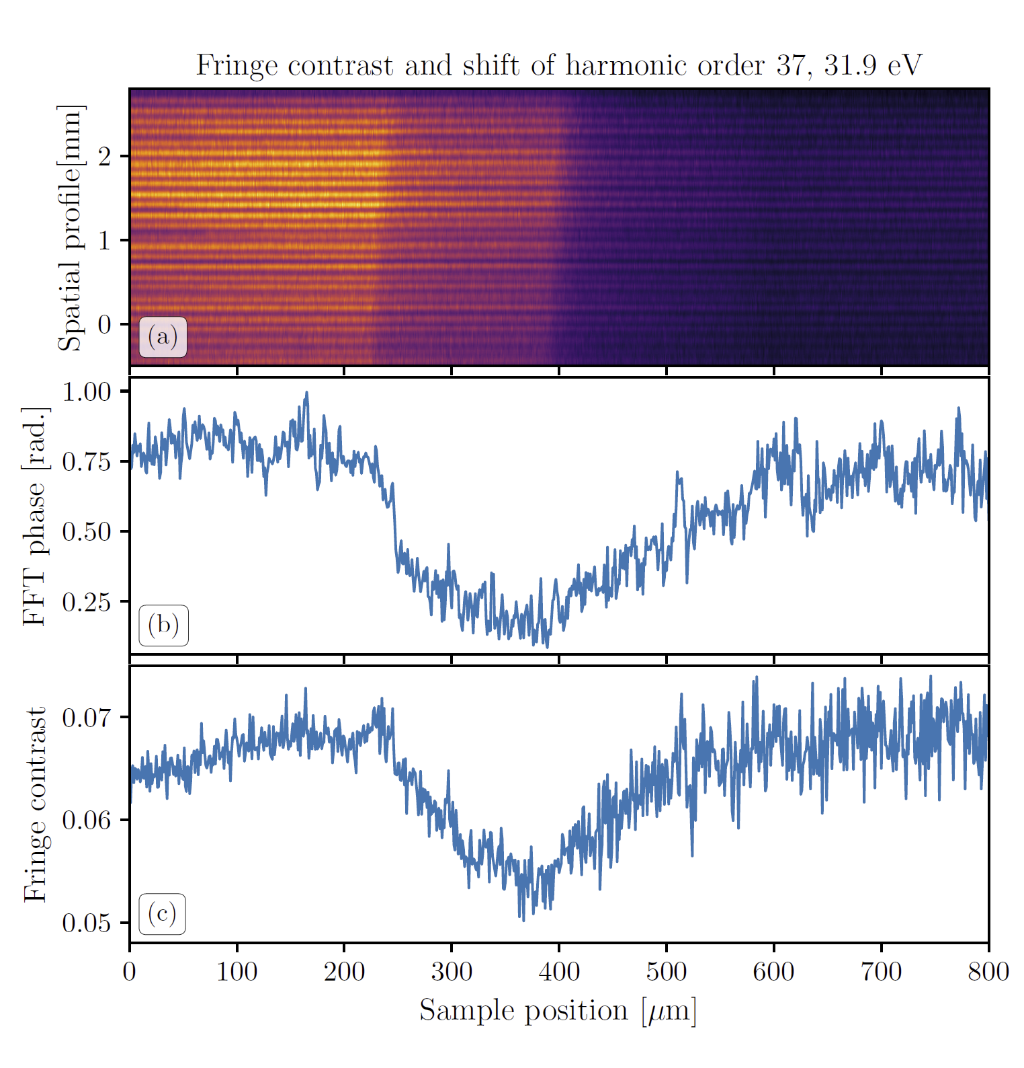
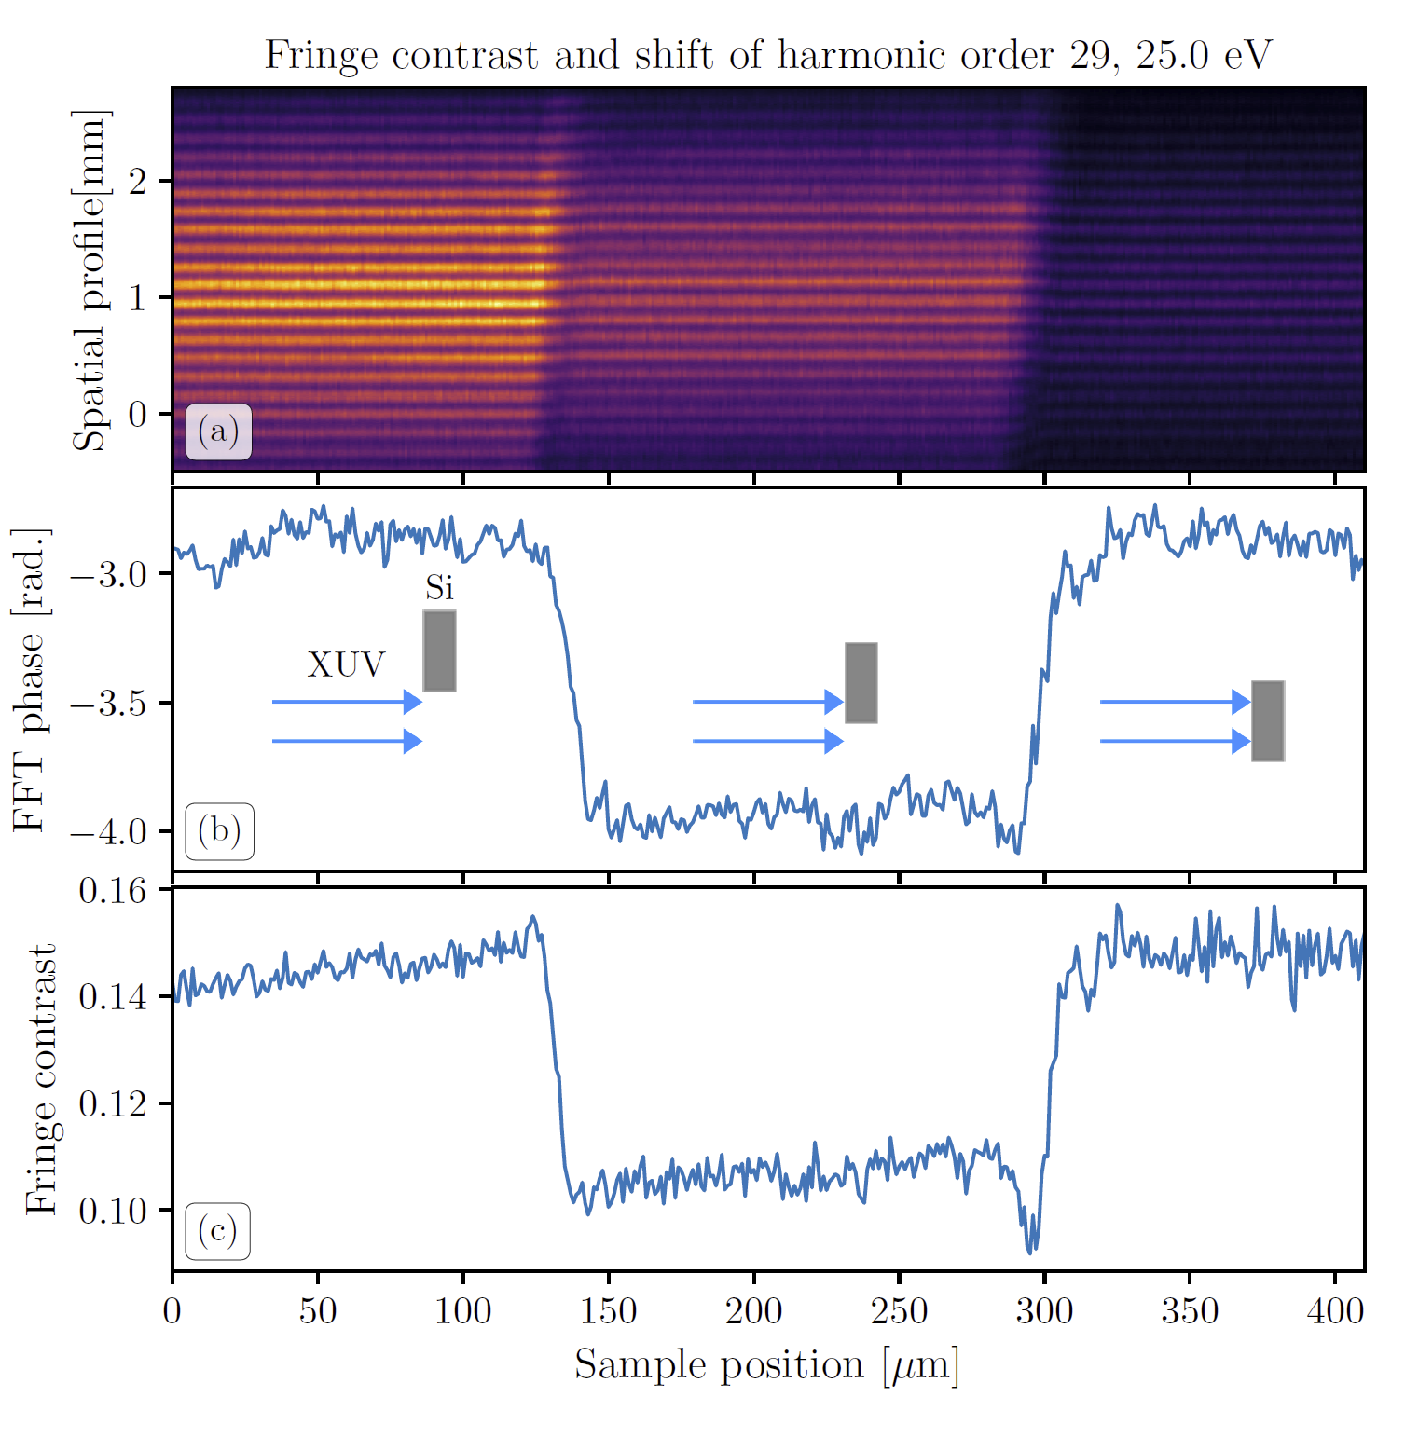
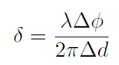
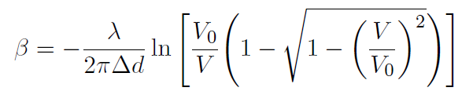
Fringe shift and contrast
Silicon
Germanium
Translating the sample through the two sources shows three distinct regimes
Only when one of the sources goes through the sample is a change in fringe contrast and fringe shift observed, as expected
Confirms that the change in fringe contrast and fringe shift is due to the sample
Real and imaginary parts of refractive index can be calculated from this, however the SWPG allows for further measurements

Slide 25



Two-source Fourier transform spectroscopy (FTS)
Combining the spatialgrams for all harmonic orders as the grating is scanned gives the interferometric autocorrelation
Scanning SWPG when only one of the two sources is going through the sample exhibits a shift due to the sample
Relative phase can be interpreted as a relative delay between the two sources
This is effectively a FTS measurement using the SWPG

Slide 26





Two-source FTS
Silicon
Fourier Trans.
1 → sample/no sample
2 → no sample/no sample
Germanium
Phase shift and transmission due to sample can be measured by Fourier transforming interferogram
Filter is applied due to low signal-to-noise

Slide 27


Complex refractive index
Silicon
Germanium
Finally, real and imaginary parts are calculated for both materials
Shows excellent agreement with literature results for both silicon and germanium
Demonstrates that the SWPG can be used to measure the ground state of a material far from an absorption edge (Si) and near an absorption edge (Ge)

Slide 28

Two-source FTS using SWPG: conclusion and outlook
Conclusion
Demonstrated the ability to directly measure the ground state complex refractive index of two different materials
SWPG allows for measurement over a broad range in the XUV → limited only by ability to resolve fringes
Single optic operation allows for a simple setup → difficulty is in sample preparation
Outlook
Next step is to measure the excited state of a system
This is done in the gas phase
Ground State
Excited State

Slide 29

Complex Attosecond Transient-absorption Spectroscopy (CATS)
SWPG was shown to be sensitive to phase shifts between the two sources → inline interferometer
Introducing a dressing pulse into one source will lead to a in refractive index that will result in a change in fringe contrast and fringe shift

Slide 30



Fano resonances in argon
System of interest are the Fano resonances in argon
Appear as a series of asymmetric deceases in absorption
Correspond to the 3s3p⁶np excited states

Slide 31




Fano resonances
Arise from interference between to ionization pathways:
Direct photoionization to continuum
Autoionization from discrete state embedded in and coupled to the continuum
Gives rise to an asymmetric absorption line shape that depends upon the balance between the two pathways → Fano profile

Slide 32






CATS delay dependence
Fringe shift and fringe contrast used to extract ΔOD and Δφ
Extracted ΔOD shows good agreement with typically measured ΔOD
Two intensities show a clear difference in features near 4p and 6p resonances
Δφ shows the emergence of a LIS near overlap at the higher intensity

Slide 33


CATS vs. Kramers-Kronig (KK)
KK relations can be used to retrieve one part of the refractive index from another
Indirect method that doesn’t always apply
Using the non-linear KK, good agreement is found at low intensity
Two methods disagree at higher intensities
Further theoretical efforts are required

Slide 34




Polarizability and dipole extraction
Finally, the amplitude and phase of the polarizability can be extracted from the complex refractive index
In principle, the dipole can be extracted from this with knowledge of the XUV phase

Slide 35
CATS: conclusion and outlook
Conclusion
Demonstrated the ability to directly measure the change in change in refractive index induced by a IR dressing pulse
Outlook
Further theoretical work is needed to fully understand the features that were observed and the breakdown of the KK relations
CATS can be used to also measure the change in refractive index in a solid due to a IR pulse

Slide 36



Thank you for your attention!

Slide 37



Attosecond Transient-absorption Spectroscopy (ATS)
Gas Cell
IR
XUV
Before the two-source measurement it is useful to understand the one-source ATS measurement

Slide 38




Fano resonances in time
In the time domain, dipole can be calculated analytically assuming a δ-function XUV pulse
Phase of the dipole determines the line shape through the q parameter: q <--> φ

Slide 39





Dipole Control Model (DCM)
Adding a δ-function IR pulse can modify the phase and amplitude of the dipole
Can be analytically calculated using DCM
Able to account for resonant and non-resonant interactions
Resonant: coupling between states in a wave packet
Non-resonant: strong-field ionization

Slide 40


Intensity dependent ΔOD
Change in absorption is given by ΔOD
Intensity dependence at temporal overlap shows several features at bright np states and in-between them

Slide 41


Light-induced attenuation (LIA)
Intensity dependence of features at the np states can be interpreted using DCM
Dressing IR pulse strongly attenuates the dipole in time due to strong-field ionization of discrete state
PPT ionization can be used to calculate the amplitude of the ΔOD
Shows good agreement with max. ΔOD at each feature, but doesn’t capture other features

Slide 42

Light-induced states (LIS)
Emergent features around np states can be describe as LIS
In this case, small detuning between bright and dark states → described by Flouqet theory
LIS states are dressed states that are dipole allowed from the ground state
Need to include all states to account for avoided crossings

Slide 43



Light-induced states (LIS)
Energy position of each LIS is extracted vs intensity
Fit the energy position of dressed states to LIS energies by varying the dipole matrix elements between states
Able to capture intensity dependence of LIS reasonably well
Extracted matrix elements can be compared to first-principle calculations

Slide 44

Delay dependence of ΔOD shows two types of features that can be separated by their Fourier energy
Oscillations at approximately 2ω
Broad low Fourier frequency features

Slide 45

Oscillations at 2ω can arise from either ionization or coupling between states through two photons
Low intensity shows features oscillating in phase at 2ω → ionization of discrete states
Higher intensities show features out of phase and a “tilting” of Fourier amplitude→ coupling of states through two photons

Slide 46

Applying a low-pass Fourier filter shows features not oscillating at a frequency near 2ω
Dressed states can be calculated for an intensity distribution given by the autocorrelation of the dressing pulse
Provides qualitative agreement that the emergent features are due to LIS described by Floquet theory

Slide 47


Argon Fano ATS: conclusion and outlook
Conclusion
Developed an intuitive understanding of the intensity- and delay-dependent features that are seen in the experiment
Serves as foundational knowledge to interpret the results that will be seen when the SWPG is applied to extract additional information
IR
XUV

Slide 48






Spatial
FFT amplitude
Spatial
FFT
Spatial
FFT phase
Phase (w/ IR) – phase (w/o IR)
Δφ vs delay

Slide 49


Slide 50




Slide 51

H31
H31
H31

Slide 52


Slide 53




Slide 54


Introduction to pump-probe techniques
Can be used to extract dynamics of a system in a pump-probe experiment
Pump pulse is used to modify the system of interest → Probe pulse follows at a variable time delay
XUV APT generally serves as the probe, and the pump is a replica of the pulse used to generate the APT

